Slide 1
Applications of Proportions
Section 1.9

Slide 2
Objectives:
Use proportions to solve problems involving geometric figures.
Use proportion and similar figures to measure objects indirectly.

Slide 3
Classwork:
Exploration: Applications of Proportions

Slide 4
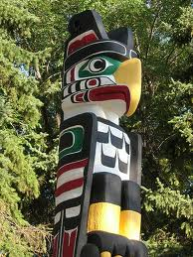
Random Facts: Why learn this?
Proportions can be used to find the heights of tall objects, such as totem poles, that would otherwise be difficult to measure.

Slide 5
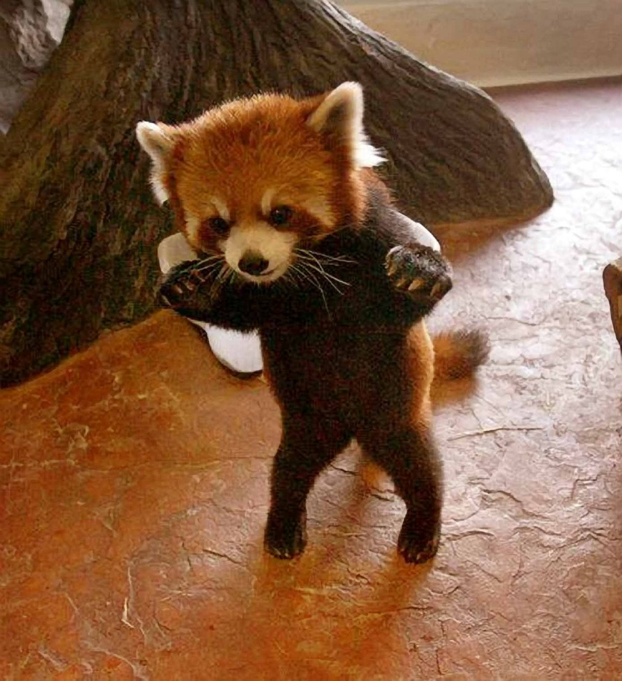
Definitions:
Similar figures have exactly the same shape, but not necessarily the same size.
Corresponding sides and corresponding angles are in the same relative position.

Slide 6
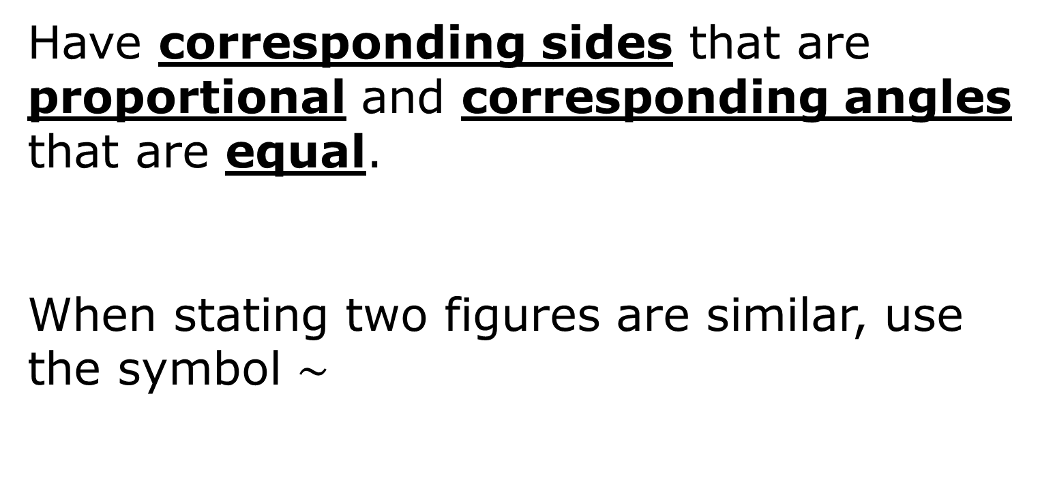
Similar Figures
Have corresponding sides that are proportional and corresponding angles that are equal.
When stating two figures are similar, use the symbol $\sim$

Slide 7
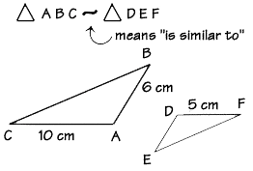
Make sure corresponding vertices are in the same order.
It would be incorrect to write $∆ABC\sim ∆EDF$

Slide 8
Similar Figures $$ABCD\sim WXYZ$$
3 cm
W
9 cm
Z
A
D
2 cm
2 cm
6 cm
6 cm
B
C
3 cm
X
Y
9 cm
Corresponding angles:
A corresponds to W.
B corresponds to X.
C corresponds to Y.
D corresponds to Z.

Slide 9
Similar Figures $$ABCD\sim WXYZ$$
3 cm
W
9 cm
Z
A
D
2 cm
2 cm
6 cm
6 cm
B
C
3 cm
X
Y
9 cm
Corresponding sides:
AB corresponds to WX.
BC corresponds to XY.
CD corresponds to YZ.
AD corresponds to WZ.

Slide 10
Similar Figures $$ABCD\sim WXYZ$$
W
9 cm
Z
A
3 cm
D
2 cm
2 cm
6 cm
6 cm
B
C
3 cm
X
Y
9 cm
In the rectangles above, one proportion is
= , or = .
AB WX
AD WZ
2 6
3 9
$$What are some other proportions?$$

Slide 11
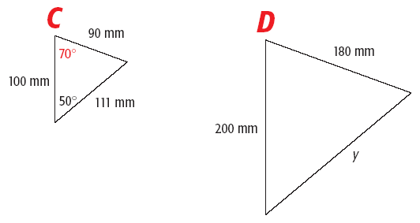

Example 1: Missing Measures in Similar Figures
a) $∆ABC\sim ∆EFD.$Find the missing length y and the measure of <D.
B
F
A
$$\frac{100}{200}=\frac{111}{y}$$
E
100y = 22,200
Angle D is congruent to angle C.
If angle C = 70°, then angle D = 70°
y = 22.2 mm

Slide 12
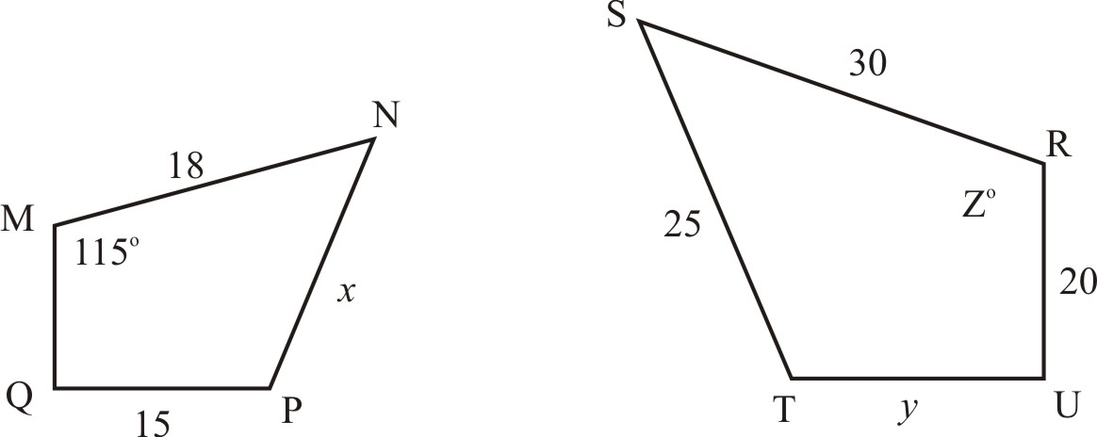

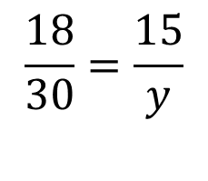
Example 1: Missing Measures in Similar Figures
b) $MNPQ\sim RSTU.$Find the missing length y, x, and the measure of Z°.
$$\frac{18}{30}=\frac{x}{25}$$
$$\frac{18}{30}=\frac{15}{y}$$
30x = 450
18y = 450
x = 15
Angle M is congruent to Z.
If angle M = 115°, then Z° = 115°
y = 25

Slide 13
Exit Ticket: (2 minutes)
List down as many pairs of real world items that appear to be similar figures.
Examples:
A model airplane and the real airplane it represents.
A baseball and a basketball.
A photograph and its enlargement.

Slide 14
Homework:
Punchline 145

Slide 15
Homework:
1.9 Exercises
Examples: 1 – 4, 6, 7, 14 – 17

Slide 16
Indirect Measurement - solving a proportion involving similar triangles to find a length that is not easily measured.
If two objects form right angles with the ground, you can apply indirect measurement using their shadows.

Slide 17
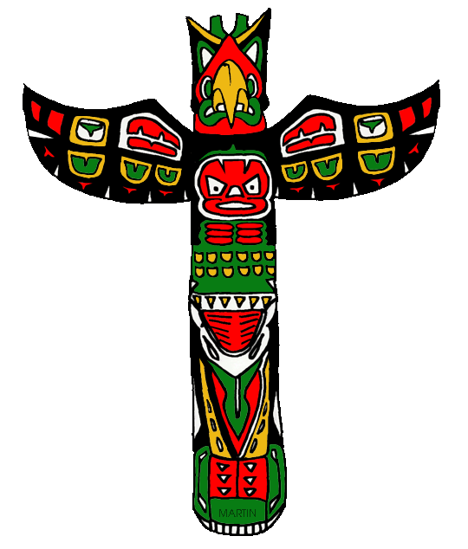
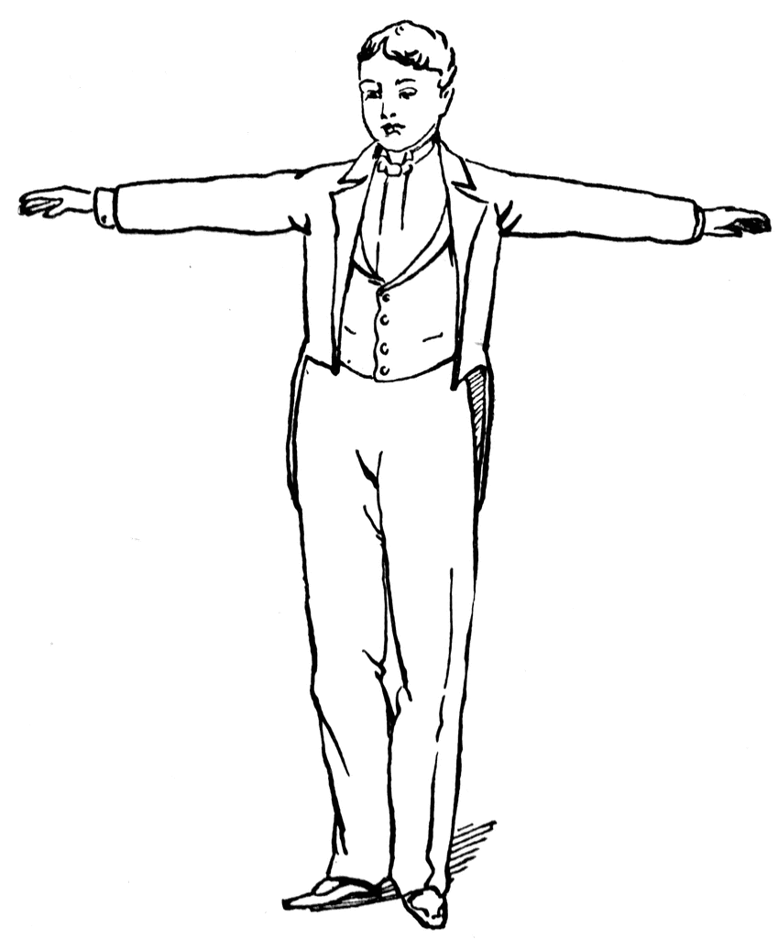
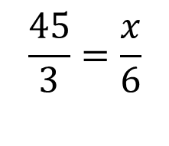
Example 2
A totem pole casts a shadow 45 feet long.
At the same time, a 6 foot tall man casts a shadow that is 3 feet long.
Find the height of the totem pole.
x ft
6 ft
45 ft
3 ft
$$\frac{45}{3}=\frac{x}{6}$$
3x = 270
x = 90
The totem pole is 90 feet tall.

Slide 18
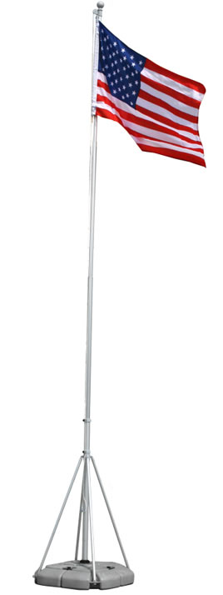
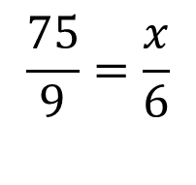
Example 3: On your own
A flag pole casts a shadow that is 75 feet long.
At the same time, a 6 foot tall man casts a shadow that is 9 feet long.
Find the height of the flag pole.
x ft
6 ft
75 ft
9 ft
$$\frac{75}{9}=\frac{x}{6}$$
9x = 450
x = 50
The flag pole is 50 feet tall.

Slide 19
Definition
If every dimension of a figure is multiplied by the same number, the result is a similar figure.
The multiplier is called a scale factor.

Slide 20
Example 4:
Every dimension of a 2 by 4 rectangle is multiplied by 1.5.
How is the ratio of the perimeters related to the ratio of the corresponding sides?
How is the ratio of the areas related to the ratio of the corresponding sides?
B
Multiply by 1.5
6 in
A
4 in
2 in
3 in

Slide 21
Example 4:
How is the ratio of the perimeters related to the ratio of the corresponding sides?
Perimeter of A = 12 in
Perimeter of B = 18 in
Ratio of perimeter: 12/18 = 2/3
Ratio of sides: 4/6 = 2/3
They are the same.
B
6 in
A
4 in
2 in
3 in

Slide 22
Example 4:
b) How is the ratio of the areas related to the ratio of the corresponding sides?
Area of A = 8 in²
Area of B = 18 in²
Ratio of areas: 8/18 = 4/9
Ratio of sides: 4/6 = 2/3
The ratios of the areas is the square of the ratio of the sides.
B
6 in
A
4 in
2 in
3 in

Slide 23
Example 5:
Every dimension of a cylinder with radius 4cm and height 6cm is multiplied by ½.
How is the ratio of the volumes related to the ratio of the corresponding dimensions?
Volume of a cylinder = $πr²h$
Volume of A: $π{\left(4\right)}^{2}(6)=96π cm³$
Volume of B: $π{\left(2\right)}^{2}(3)=12π cm³$
4 cm
6 cm
Multiply by 0.5
2 cm
A
3 cm
B

Slide 24
Example 5:
Volume of A: $π{\left(4\right)}^{2}(6)=96π cm³$
Volume of B: $π{\left(2\right)}^{2}(3)=12π cm³$
Ratio of the radii: 4/2 = 2
Ratio of the heights: 6/3 = 2
Ratio of the volumes: $96π$/$12π$ = 8
The ratio of the volumes is the cube of the ratio of corresponding sides.
4 cm
6 cm
2 cm
A
3 cm
B

Slide 25
Exit Ticket (5 minutes)
If you know the lengths of the sides of two figures, how can you show that the figures are similar?
Draw two similar figures.

Slide 26
Homework:
1.9 Additional Practice Problems

