Slide 1
Arithmetic Sequences
Section 3.6

Slide 2
Objectives:
Recognize and extend an arithmetic sequence.
Find a given term of an arithmetic sequence.

Slide 3
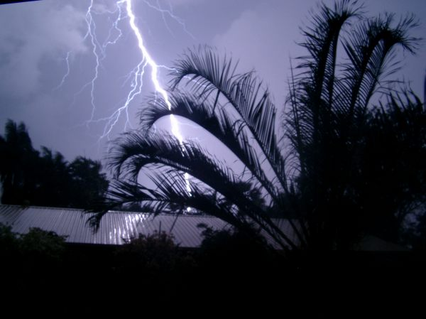
Random Fact: Why learn this?
The distance between you and a lightening strike can be determined using an arithmetic sequence.

Slide 4
Classwork:
3.6 Exploration: Arithmetic Sequences

Slide 5
Definitions:
A sequence is a list of numbers that may form a pattern.
Each number is a term.
Arithmetic Sequence: When the terms of the sequence differ by the same number.
d is the common difference.
a is used to represent the terms.
$a_{n}$ represents the n^{th} term of the sequence.
Example: $a_{9}$ represents the 9th term of the sequence.

Slide 6
Finding a Term of an Arithmetic Sequence:
To find a term in an arithmetic sequence, add d to the previous term.
The nth term of an arithmetic sequence with a common difference d is:
$$a_{n}=a_{n−1}+d$$

Slide 7
Example 1:
Determine whether the sequence appears to be an arithmetic sequence.
If so, determine the common difference and the next 3 terms.
12, 8, 4, 0, …
Yes.
d = -4
Next 3 terms: -4, -8, -12.

Slide 8
Example 1:
Determine whether the sequence appears to be an arithmetic sequence.
If so, determine the common difference and the next 3 terms.
b) 1, 4, 9, 16, …
No.
There is no common difference.

Slide 9
How do you find the nth term of a sequence when n is very large?
d = 4
a1 = 3
+4
+4
+4
+4
3, 7, 11, 15, 19 …
Each time you want another term in the sequence you’d add d.
This would mean the second term was the first term plus d.
The third term is the first term plus 2d.
The fourth term is the first term plus 3d.
To get the nth term, we take the first term and add d (n - 1) times.

Slide 10
+4
+4
+4
+4
d = 4
a1 = 3
3, 7, 11, 15, 19 …
Try this to get the 5th term.

Slide 11
Finding the nth Term of an Arithmetic Sequence
The nth term of an arithmetic sequence with a common difference d and first term a1 is:
$$a_{n}=a_{1}+\left(n−1\right)d$$

Slide 12
Example 2:
Find the indicated term of the arithmetic sequence.
a) 22nd term: 5, 2, -1, -4, …
Step 1: Find the common difference.
d = -3
Step 2: Find the 22nd term.
$$a_{n}=a_{1}+\left(n−1\right)d$$
$$a_{22}=5+\left(22−1\right)(−3)$$
$$a_{22}=5+\left(21\right)(−3)$$
$$a_{22}=−58$$

Slide 13
Example 2:
Find the indicated term of the arithmetic sequence.
b) 16th term: 4, 8, 12, 16, …
Step 1: Find the common difference.
d = 4
Step 2: Find the 16th term.
$$a_{n}=a_{1}+\left(n−1\right)d$$
$$a_{16}=4+\left(16−1\right)4$$
$$a_{16}=4+\left(15\right)4$$
$$a_{16}=64$$

Slide 14
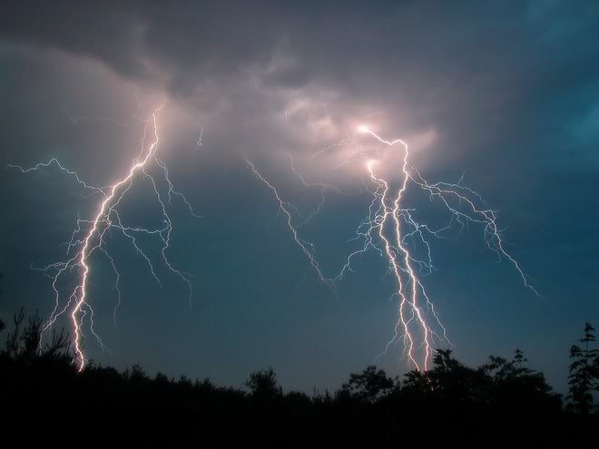
Example 3:
During a thunderstorm, you can estimate your distance from a lightening strike by counting the number of seconds from the time you see the lightening until the time you hear the thunder.
1 second → 0.2 miles away
2 seconds → 0.4 miles away
3 seconds → 0.6 miles away
4 seconds → 0.8 miles away
5 seconds → 1 mile away
Etc…
How far away are you from a lightening strike if you count 13 seconds?

Slide 15
Example 3 Continued:
How far away are you from a lightening strike if you count 13 seconds?
Step 1: Find the common difference.
d = 0.2
Step 2: Find the 13th term.
$$a_{n}=a_{1}+\left(n−1\right)d$$
$$a_{13}=0.2+\left(13−1\right)(0.2)$$
$$a_{13}=0.2+\left(12\right)(0.2)$$
$$a_{13}=2.6$$
You are 2.6 miles away from the lightening strike.

Slide 16
Exit Ticket (5 minutes)
Explain how to determine if a sequence appears to be arithmetic.
Give an example of your own arithmetic sequence.

Slide 17
Homework:
3.6 Homework: Arithmetic Sequences

