Slide 1
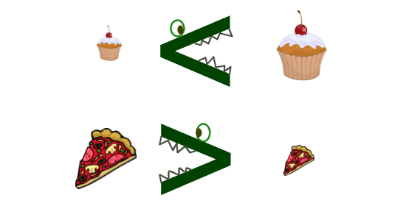
Graphing and Writing Inequalities
Section 2.1

Slide 2
Objectives:
Identity solutions of inequalities in one variable.
Write and graph inequalities in one variable.

Slide 3
Classwork:
Exploration: Graphing and Writing Inequalities

Slide 4
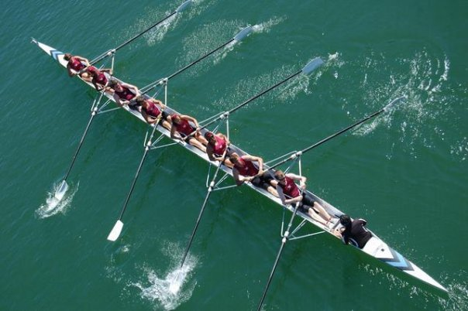
Random Fact: Who uses this?
Members of a crew team can use inequalities to be sure they fall within a range of weights.

Slide 5
Definition:
An inequality is a statement that two quantities are not equal.
The quantities are compared using one of the following:
< Less than
> Greater than
≤ Less than or equal to
≥ Greater than or equal to
≠ Not equal to
A solution of an inequality is any value that makes the inequality true.

Slide 6
Example 1:
Describe the solutions of x – 6 ≥ 4 in words.
Let’s test some values.
What values of x will work?
x = -2 → -2 – 6 ≥ 4?
Nope
x = 5 → 5 – 6 ≥ 4?
Nope
x = 9 → 9 – 6 ≥ 4?
Nope
x = 10 → 10 – 6 ≥ 4?
Yes
x = 11 → 11 – 6 ≥ 4?
Yes
Solution: All real numbers greater than or equal to 10.

Slide 7
We can use a graph to show all of the solutions to the last example.
Solution: All real numbers greater than or equal to 10.
x ≥ 10

Slide 8
Graphing Inequalities
Use an open circle for < and >.
Use a closed circle for ≤ and ≥.
If it is less than, shade to the left.
If it is greater than, shade to the right.

Slide 9
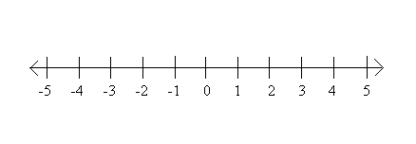
Example 2:
Write each inequality in words. Then Graph each inequality.
m≥ ¾
m is greater than or equal to ¾.
b) t < 5(-1 + 3)
t < 5(2)
t < 10
t is less than 10.

Slide 10
Example 3:
Write the inequality shown by the graph.
a)
x < -1
b)
x > 3

Slide 11
Example 3:
Write the inequality shown by the graph.
c)
x ≥ 2
d)
x ≤ 4

Slide 12
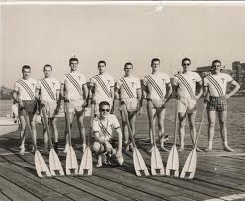
Example 4:
The members of a crew team can weigh no more than 165 pounds each.
a) Write an inequality for the acceptable weights of the team members.
b) Graph the solution.
0 < W ≤ 165
0 30 60 90 120 150 180

Slide 13
Exit Ticket (2 minutes)
Explain the difference between x > 2 and x ≥ 2.
Use as many examples as possible.

Slide 14
Classwork:
Graphing Inequalities Worksheet
(Double Sided)

Slide 15
Homework:
2.1 Additional Practice Worksheet

