Slide 1
Graphing Relationships
Section 3.1

Slide 2
Objectives:
Match simple graphs with situations.
Graph a relationship.

Slide 3
Classwork:
Exploration: Graphing Relationships

Slide 4
Random Fact: Who uses this?
Cardiologists can use graphs to analyze their patient’s heartbeats.

Slide 5
Introduction:
Graphs can be used to illustrate many different situations.
To relate a graph to a given situation, use key words in the description.

Slide 6
Examples of Key Words:
Stays the same – Constant
Rises – Increasing
Drops – Decreasing
Slows down – Decreasing

Slide 7
Example 1: Relating Graphs to Situations
For a certain time, Kim Possible jogs up a hill at a steady speed.
Then she runs down the hill and picks up her speed.
Which graph accurately represents this situation?

Slide 8
Which graph works best?
For a certain time Kim Possible jogs up a hill at a steady speed. Then she runs down the hill and picks up her speed. Which graph below accurately represents this situation?
GRAPH 1
GRAPH 2
GRAPH 3
SPEED
SPEED
SPEED
TIME
TIME
TIME

Slide 9
Which graph works best?
What information can we use?
Steady speed – constant/horizontal
She speeds up - Slanting upwards
GRAPH 1
GRAPH 2
GRAPH 3
SPEED
SPEED
SPEED
TIME
TIME
TIME

Slide 10
Example 2: Relating Graphs to Situations
The air temperature was constant for several hours at the beginning of the day, then rose steadily for several hours.
It stayed the same temperature for most of the day before dropping sharply at sundown.
Choose the graph that best represents the situation.
Graph A
Graph B
Graph C
Temperature
Temperature
Temperature
Time
Time
Time

Slide 11
Example 2: Relating Graphs to Situations
Step 1: Always read the graph left to right to show time passing.
Step 2: List key words and what they mean.
Was constant – Horizontal
Rose steadily – Slanting upwards
Stayed the same – Horizontal
Dropped sharply – Slanting downward
Graph A
Graph B
Graph C
Temperature
Temperature
Temperature
Time
Time
Time

Slide 12
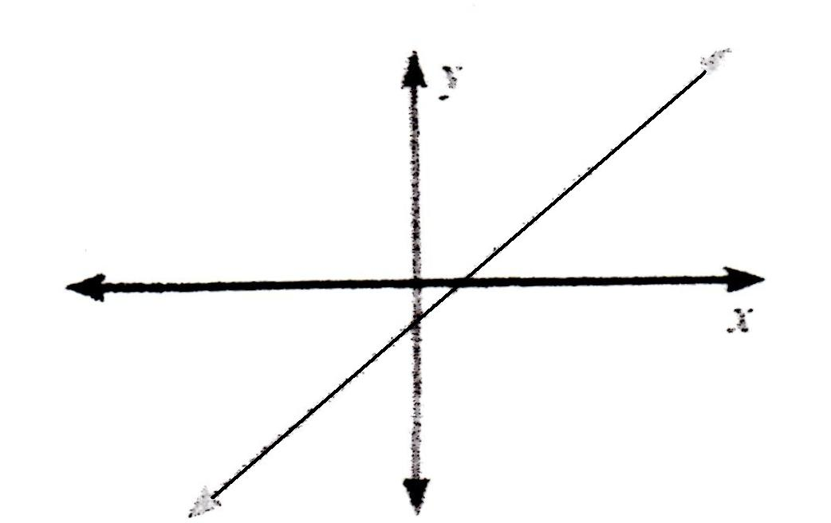
Continuous Graphs
The graph is an unbroken line or curve.
It makes sense to connect the points in this situation.

Slide 13
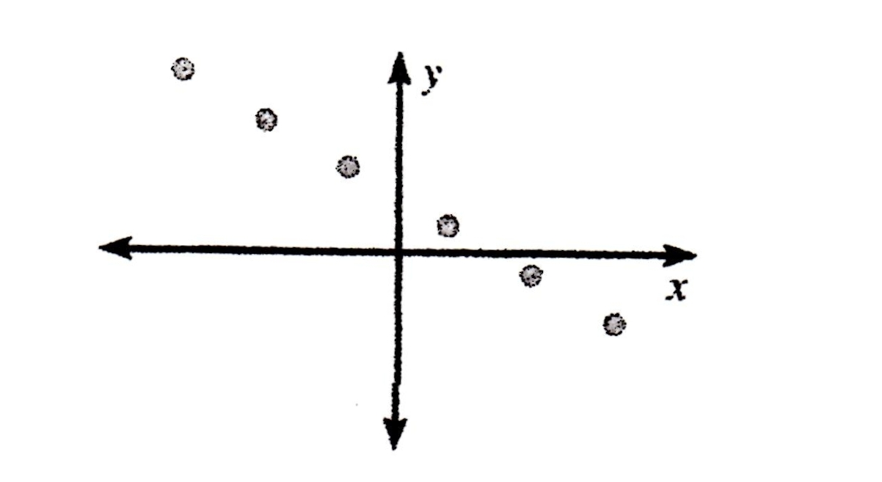
Discrete Graphs
The graph consists of separate points.
It makes no sense to connect the points in this situation.

Slide 14
Example 3:
Sketch a graph for each situation.
Tell whether the graph is continuous or discrete.
a)
Simon is selling candles to raise money for the school dance.
For each candle he sells, the school will get $2.50.
He has 10 candles that he can sell.
25
20
15
10
5
The graph is discrete!
Amount Earned ($)
0 1 2 3 4 5 6 7 8 9 10
Candles Sold

Slide 15
Example 3:
Sketch a graph for each situation.
Tell whether the graph is continuous or discrete.
b) A truck driver enters a street, drives at a constant speed, stops at a light, and then continues.
The graph is continuous!
Speed
Time

Slide 16
When sketching or interpreting a graph, pay close attention to the labels on each axis.
Both graphs below show a relationship about a child going down a slide.
Graph A represents the child’s speed over time.
Graph B represents the child’s distance from the ground over time.
Graph B
Graph A
Speed
Distance from Ground
Time
Time

Slide 17
Example 4:
Write a possible situation for the graph.
Step 1: Identify labels.
x-axis: Time y-axis: Water Level
Step 2: Analyze sections.
Over time, the water level…
Increases steadily, remains unchanged, and then decreases steadily.
Possible situation: A watering can is filled with water. It sits for a while until flowers are planted. The water is then emptied on top of the flowers.
Water Level
Time

Slide 18
Collin’s Writing (5 minutes)
Write a possible situation for the graph.
CANNOT USE:
A Possible situation: A car is approaching traffic and slows down, drives at a constant speed, then slows down until coming to a complete stop.
Speed
Time

Slide 19
Homework:
3.1 Practice A Worksheet (Double Sided)

