Slide 1
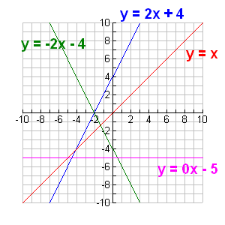
Identifying Linear Functions
Section 4.1

Slide 2
Objectives:
Identify linear functions and linear equations.
Graph linear functions that represent real-world situations and give their domain and range.

Slide 3
Random Fact: Why learn this?
Linear functions can describe many real-world situations such as distances travelled at a constant speed.

Slide 4
What is a Linear Function?
y
A linear function is a function whose graph is a LINE.
Linear
Not Linear
x
Note: A line could be horizontal, vertical, or diagonal

Slide 5
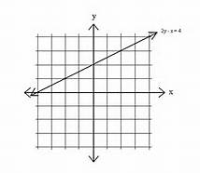
Example 1: Identify whether each graph represents a function. If it does, is it linear?
a)
Yes this is a function
Yes this is a linear function.

Slide 6
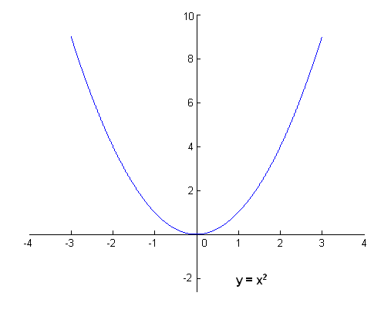
Example 1: Identify whether each graph represents a function. If it does, is it linear?
b)
Yes, this is a function
No, this is a NOT a linear function.

Slide 7
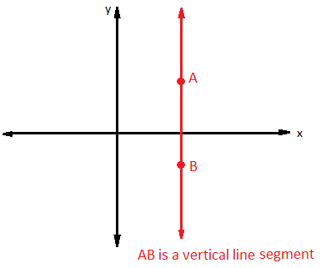
Example 1: Identify whether each graph represents a function. If it does, is it linear?
c)
No, this is NOT a function.

Slide 8
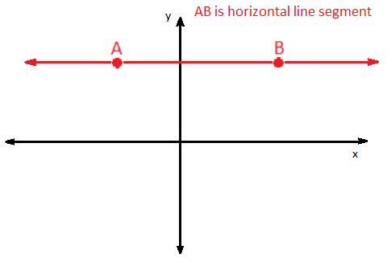
Example 1: Identify whether each graph represents a function. If it does, is it linear?
d)
Yes, this is a function
Yes, this is a linear function.

Slide 9
Looking at a table to identify linear functions: A constant difference in consecutive x-values results in a constant difference in consecutive y-values.
Example 2:
Do the ordered pairs satisfy a function?
Yes
b) What is the y-value that corresponds to an x-value of 20?
41
x | 2 | 5 | 8 | 11 | 14 | 17
y | 5 | 11 | 17 | 23 | 29 | 35

Slide 10
Example 3:
Is y = x³ a linear function?
Fill in the rest of the chart to figure it out.
No
x | 1 | 2 | 3 | 4
y

Slide 11
Example 4:
Do the ordered pairs satisfy a linear function?
{(3, 5), (5, 4), (7, 3), (9, 2), (11, 1)}
Yes

Slide 12
Homework:
4.1 Homework #1: Identifying Linear Functions

Slide 13
You can also determine a linear function by looking at its equation.
A linear equation is an equation representing a linear relationship.
Its graph is a line.

Slide 14
Standard Form of a Linear Equation:
Ax + By = C
A, B, and C are real numbers.
A and B cannot equal 0.

Slide 15
Linear vs. Non-Linear
Examples of Linear Equations:
3x + 2y = 10
y – 2 = 3x
Can re-write as 3x – y = -2
-y = 5x
Can re-write as 5x + y = 0

Slide 16
Linear vs. Non-Linear
Examples of Non-Linear Equations:
3xy + x = 1
x² – y = -2
5x + $\frac{6}{y}$ = 10

Slide 17
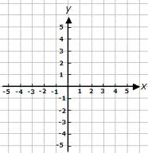
Graphs of Linear Equations
Example 5: Tell whether y = 2x – 1 is linear. If so, graph the function using a table of values.
Yes it is Linear
x | y
1 | 1
2 | 3
3 | 5
4 | 7

Slide 18
Classwork: Graphing Calculator Extension
Graph the following.
Are they linear or nonlinear? Why or why not?
3x – 5 = y
y = 3
y = $\frac{1}{x}$
y = (2x + 1)(2x – 1)

Slide 19
Homework:
4.1 Homework #2: Identifying Linear Functions

Slide 20
Domain and Range of Linear Functions
Linear functions that are not horizontal have a domain and range of all real numbers.
However, the real world may limit the domain and range.
Examples:
Time cannot be negative.
You cannot have a half of a person.

Slide 21
Example 6:
Verizon charges $5.00 per month and $0.50 per minute for each call.
Write an equation to represent the total monthly cost.
Make a table of values for the total charges for 0, 1, 2, 3, 4, and 5 min.
c) Graph the function.
d) What is the domain and range?

Slide 22
Example 6:
Verizon charges $5.00 per month and $0.50 per minute for each call.
Write a linear function to represent the total monthly cost.
f(x) = 0.50x + 5

Slide 23
Example 6:
Verizon charges $5.00 per month and $0.50 per minute for each call.
b) Make a table of values for the total charges for 0, 1, 2, 3, 4, and 5 min.
f(x) = 0.50x + 5
x (min) | y (cost)
0 | 5.00
1 | 5.50
2 | 6.00
3 | 6.50
4 | 7.00
5 | 7.50

Slide 24
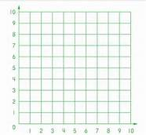
Example 6:
Verizon charges $5.00 per month and $0.50 per minute for each call.
c) Graph the function.
f(x) = 0.50x + 5
x (min) | y (cost)
0 | 5.00
1 | 5.50
2 | 6.00
3 | 6.50
4 | 7.00
5 | 7.50

Slide 25
Example 6:
d) What is the domain and range?
Domain: {0, 1, 2, 3, 4, 5}
Range: {5.00, 5.50, 6.00, 6.50, 7.00, 7.50}
f(x) = 0.50x + 5
x (min) | y (cost)
0 | 5.00
1 | 5.50
2 | 6.00
3 | 6.50
4 | 7.00
5 | 7.50

Slide 26
Example 7:
A 200-gallon tank is half full when Darla begins to fill it. The water flows in at a rate of 10 gallons per minute.
a) Write a linear function to find the volume, y, in gallons of water over time, x, in minutes.
b) Graph the function using a table of values.
c) What is the domain and range?

Slide 27
Example 7:
A 200-gallon tank is half full when Darla begins to fill it. The water flows at a rate of 10 gallons per minute.
a) Write a linear function to find the volume, y, in gallons of water over time, x, in minutes.
y = 10x + 100

Slide 28
Example 7:
A 200-gallon tank is half full when Darla begins to fill it. The water flows at a rate of 10 gallons per minute.
b) Graph the function.
y = 10x + 100
200
180
160
140
120
100
80
60
40
20
x (min) | y (gallons)
0 | 100
1 | 110
2 | 120
3 | 130
4 | 140

Slide 29
Example 7:
x (min) | y (gallons)
0 | 100
1 | 110
2 | 120
3 | 130
4 | 140
c) What is the domain and range?
Domain: $0≤x≤10$
Range: 10$0≤y≤200$
y = 10x + 100
200
180
160
140
120
100
80
60
40
20

Slide 30
Exit Ticket: (5 minutes)
Suppose you are given a function and 5 ordered pairs that satisfy the function.
When you graph the points, 4 of the points lie on a straight line. The fifth point does not lie on the straight line.
Is the function linear? Why or why not?

Slide 31
Homework:
4.1 Practice A (Double Sided)

