Slide 1
Precision and Accuracy
Section 1.10

Slide 2
Objectives:
Analyze and compare measurements for precision and accuracy.
Choose an appropriate level of accuracy when reporting measurements.

Slide 3
Classwork:
Exploration: Precision and Accuracy

Slide 4
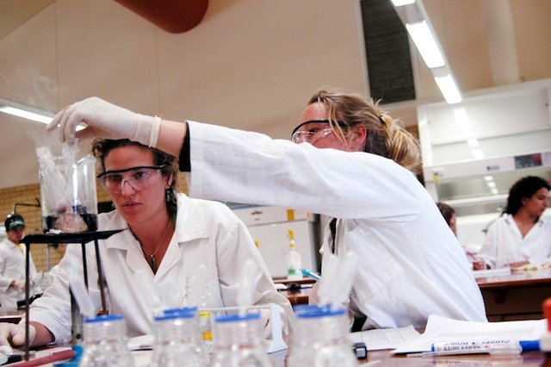
Random Fact: Who uses this?
Chemists must understand precision and accuracy when weighing or mixing specific amounts of chemicals.

Slide 5
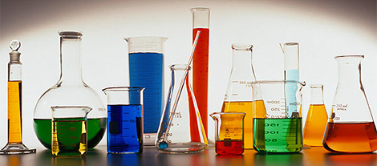
Introduction to Precision
When you measure an object, you must use an instrument that will give an appropriate measurement.

Slide 6
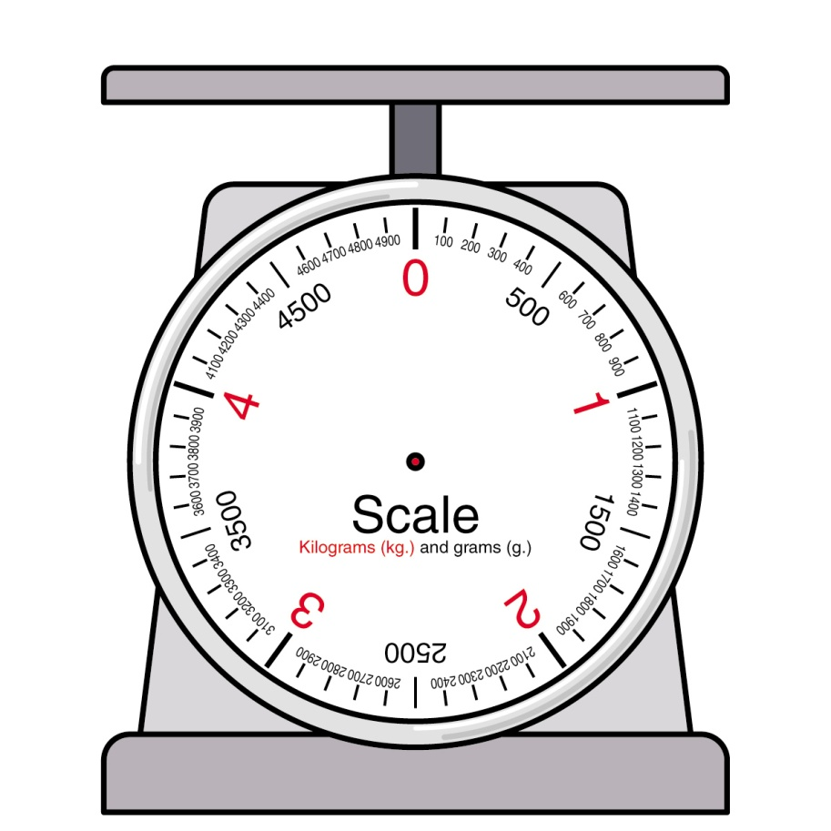
Introduction to Precision
A scale to measure the mass of a person may show mass to the nearest kilogram.

Slide 7
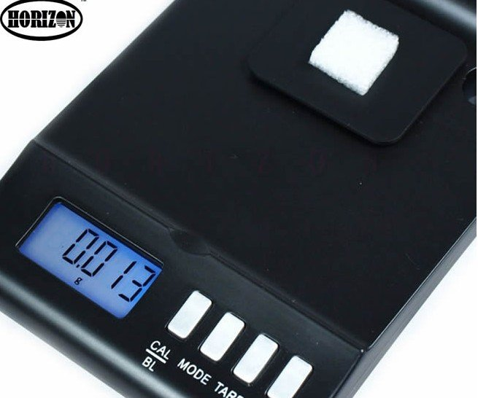
Introduction to Precision
A scale to measure chemicals in a lab may show mass to the nearest milligram.

Slide 8
Definition:
Precision is the level of detail in a measurement.
It is determined by the smallest unit or fraction of a unit that you can reasonably measure.
Sometimes the instrument determines the precision.
Other times, measurements are rounded to a specified precision.

Slide 9
More on Precision
A scale that shows the mass of an object to the nearest milligram is more precise than a scale that shows the mass to the nearest kilogram.
This is because a milligram is a smaller unit of measure.

Slide 10
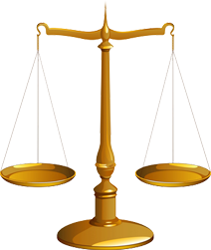
More on Precision
A scale that shows the mass of an object as 24.23 grams is more precise than a scale that reads 24.2 grams.

Slide 11
Example 1:
Chose the more precise measurement.
a) 0.8 kilometers or 830.2 meters
830.2 meters
b) 2.45 inches or 2.5 inches
2.45 inches
c) 100 centimeters or 1 meter
100 centimeters
d) 2 pounds or 17 ounces
17 ounces

Slide 12
Definition:
A precise measurement is only useful if the measurement is accurate.
The accuracy of a measurement is the closeness of a measured value to the actual value.

Slide 13
Example 2:
Ida works in a deli.
She is testing the scales to make sure they are accurate.
She uses a weight that is exactly 1 pound and gets the following results.
Scale 1: 1.019 lb
Scale 2: 1.01 lb
Scale 3: 0.98 lb
a) Which scale is the most precise?
Scale 1
b) Which scale is most accurate?
Scale 2

Slide 14
Homework:
1.10 Exercises
Examples: 1 – 10, 37-42

Slide 15
Definition:
When you measure a group of objects that are expected to be the same, you may find that there are variations from the expected value.
Tolerance describes the amount by which an object is permitted to vary from a specified value.
Tolerance is often expressed as a range of values.
Example:
5 mm ± 0.3 mm
This means 4.7 mm – 5.3 mm

Slide 16
Example 3:
Bright Days Blinds makes window shades.
The width of a 30-inch shade should be within 0.18 in. of 30 in.
A batch of shades has the widths shown in the table.
What is the tolerance?
Do all the shades measure within the specified tolerance?
C) If not, which shades are not within the specified tolerance?
Shade | Width (in.)
A | 30.06
B | 29.75
C | 29.84
D | 30.12
E | 29.93

Slide 17
Example 3:
Bright Days Blinds makes window shades.
The width of a 30-inch shade should be within 0.18 in. of 30 in.
A batch of shades has the widths shown in the table.
What is the tolerance?
Lowest: 30 – 0.18 = 29.82
Highest: 30 + 0.18 = 30.18
Shade | Width (in.)
A | 30.06
B | 29.75
C | 29.84
D | 30.12
E | 29.93
Tolerance: 29.82 – 30.18

Slide 18
Example 3:
Bright Days Blinds makes window shades.
The width of a 30-inch shade should be within 0.18 in. of 30 in.
A batch of shades has the widths shown in the table.
B) Do all the shades measure within the specified tolerance?
NO
Shade | Width (in.)
A | 30.06
B | 29.75
C | 29.84
D | 30.12
E | 29.93
Tolerance: 29.82 – 30.18

Slide 19
Example 3:
Bright Days Blinds makes window shades.
The width of a 30-inch shade should be within 0.18 in. of 30 in.
A batch of shades has the widths shown in the table.
C) If not, which shades are not within the specified tolerance?
Shade B
Shade | Width (in.)
A | 30.06
B | 29.75
C | 29.84
D | 30.12
E | 29.93
Tolerance: 29.82 – 30.18

Slide 20
More on Tolerance:
Tolerance can also be expressed as a percent.
Example:
A measurement written as 5 mm ± 5% means that the value can be greater than or less than the amount by 5% of 5 mm.
To find the tolerance:
5% of 5 mm → .05(5) = 0.25 mm
Lowest: 5 – 0.25 = 4.75
Highest: 5 + 0.25 = 5.25
Tolerance: 4.75 mm – 5.25 mm

Slide 21
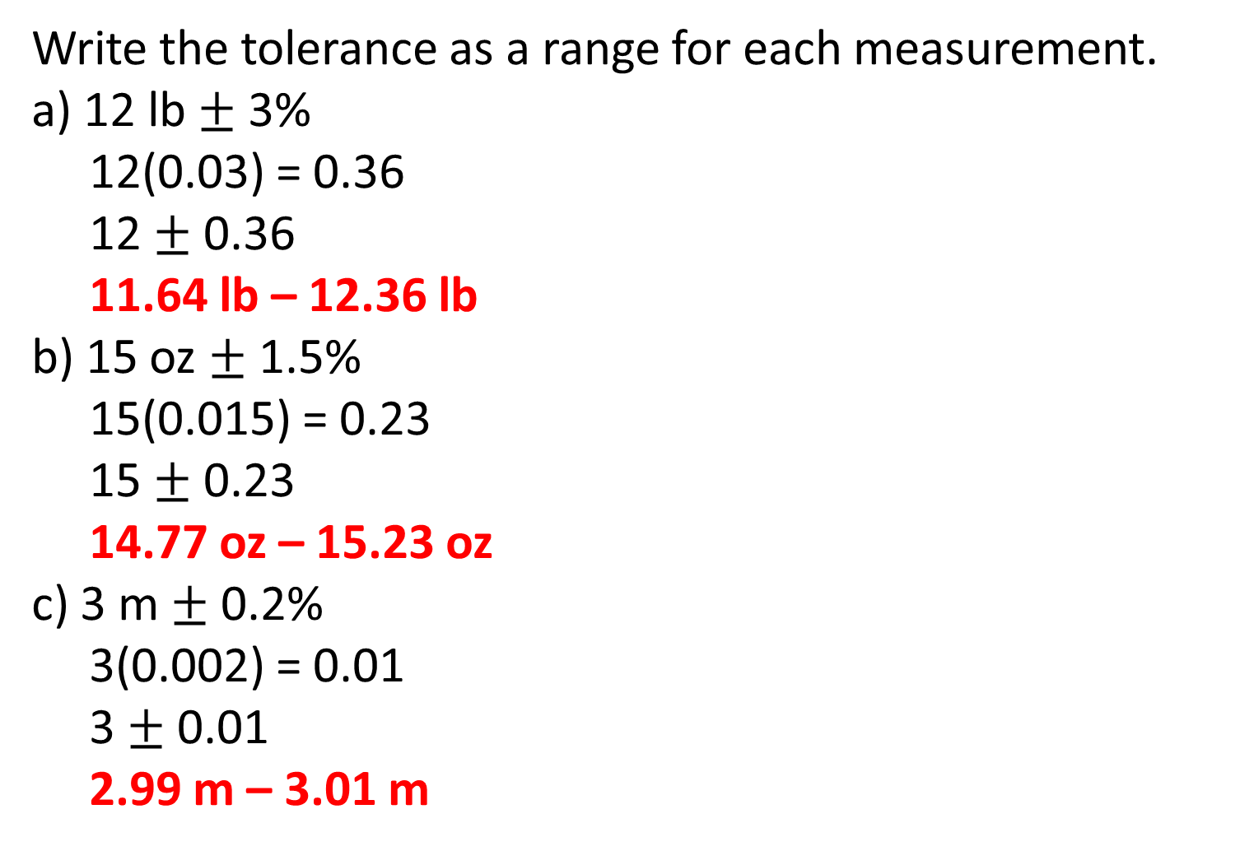
Example 4:
Write the tolerance as a range for each measurement.
a) 12 lb $±$ 3%
12(0.03) = 0.36
12 $±$ 0.36
11.64 lb – 12.36 lb
b) 15 oz $±$ 1.5%
15(0.015) = 0.23
15 $±$ 0.23
14.77 oz – 15.23 oz
c) 3 m $±$ 0.2%
3(0.002) = 0.01
3 $±$ 0.01
2.99 m – 3.01 m

Slide 22
Exit Ticket (5 minutes)
Explain the difference between precision and accuracy.

Slide 23
Homework:
1.10 Additional Practice Problems

