Slide 1
Rate of Change and Slope
Section 4.3

Slide 2
Objectives:
Find rates of change and slopes.
Relate a constant rate of change to the slope of a line.

Slide 3
“Do Now”
Exploration 4.3
Rates of Change and Slope

Slide 4

Random Fact: Why learn this?
Rates of change can be used to find how quickly costs have increased.

Slide 5

Rates of Change:
$$Rate of Change=\frac{Change in dependent variable }{Change in independent variable}$$

Slide 6
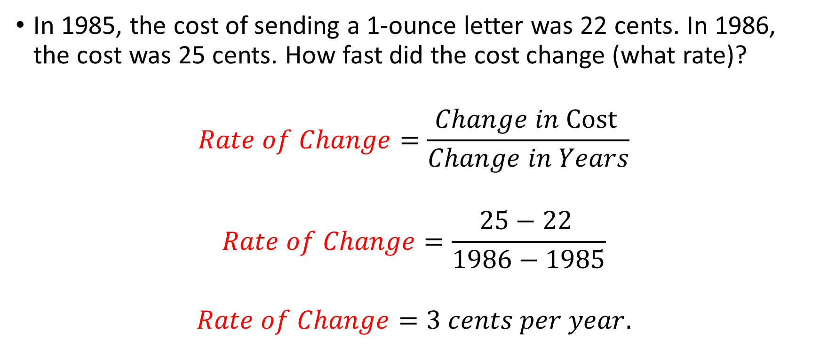
Example 1:
In 1985, the cost of sending a 1-ounce letter was 22 cents. In 1986, the cost was 25 cents. How fast did the cost change (what rate)?
$$Rate of Change=\frac{Change in \text{Cost} }{Change in Years}$$
$$Rate of Change=\frac{\text{25 − 22} }{1986−1985}$$
$$Rate of Change=3 cents per year.$$

Slide 7
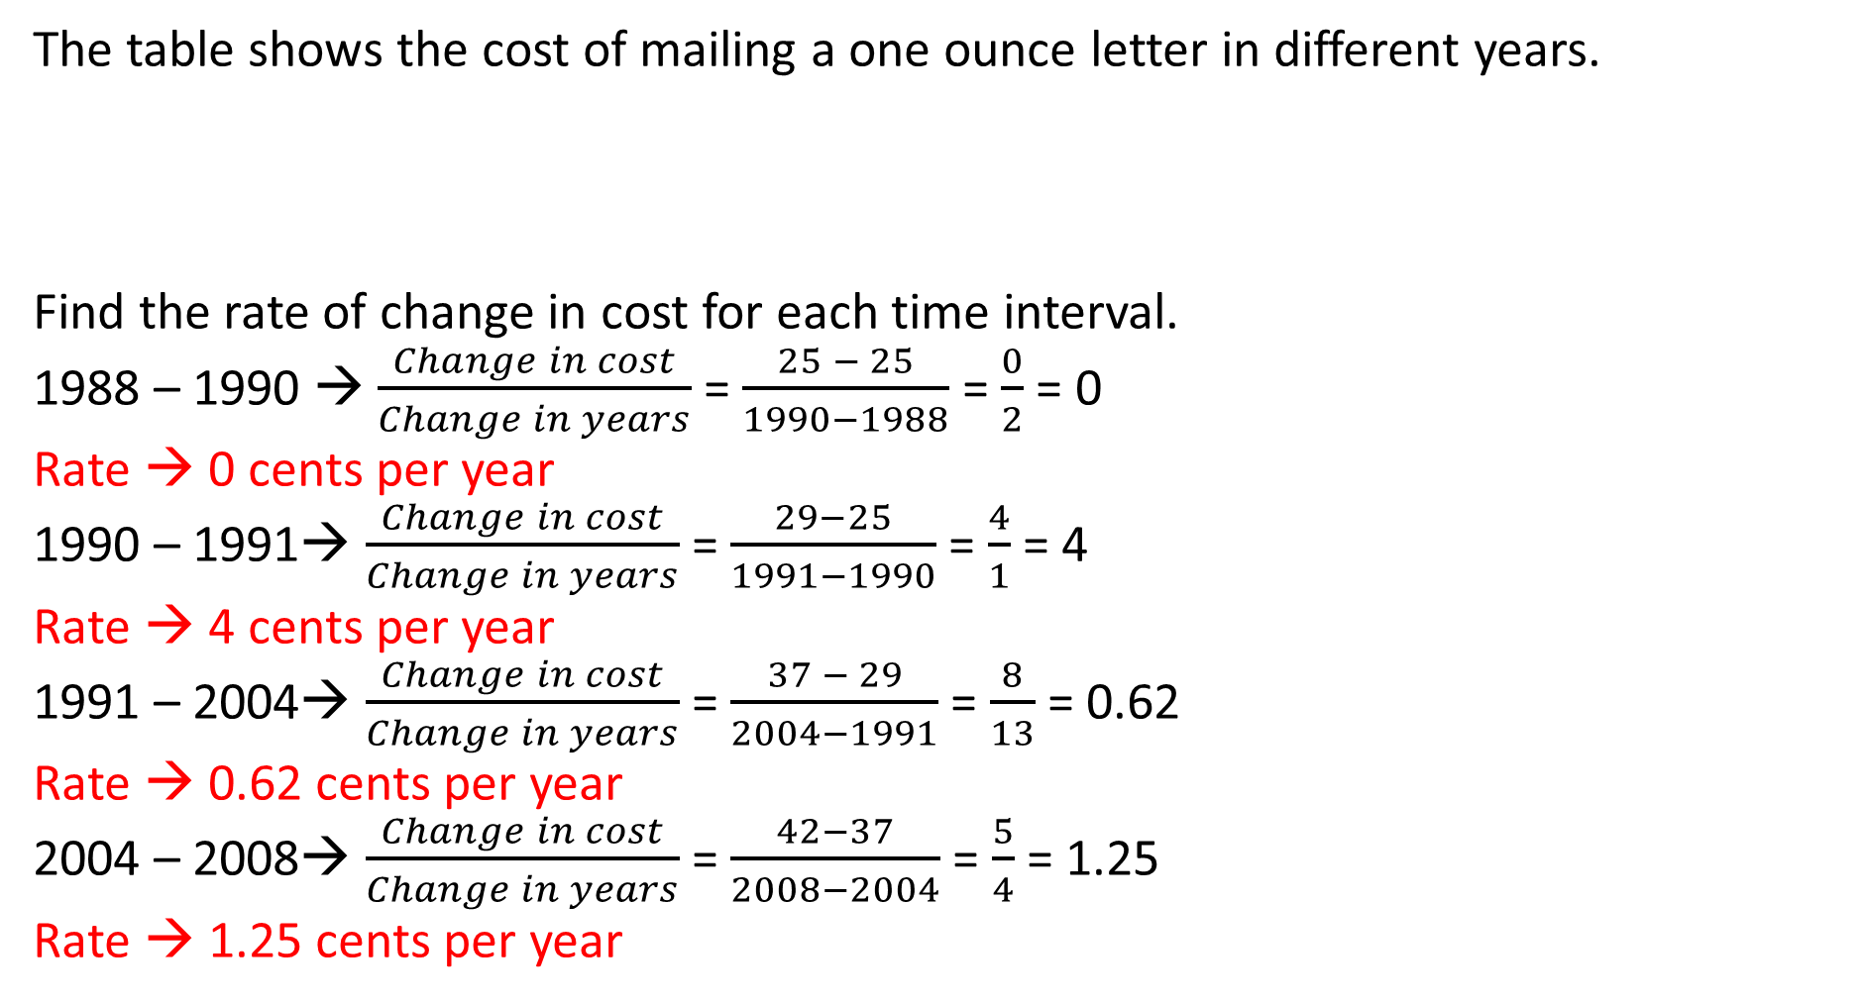
Example 2:
The table shows the cost of mailing a one ounce letter in different years.
Find the rate of change in cost for each time interval.
1988 – 1990 → $\frac{Change in cost}{Change in years}$ = $\frac{25 − 25}{1990−1988}$ = $\frac{0}{2}$ = 0
Rate → 0 cents per year
1990 – 1991→ $\frac{Change in cost}{Change in years}$ = $\frac{29−25}{1991−1990}$ = $\frac{4}{1}$ = 4
Rate → 4 cents per year
1991 – 2004→ $\frac{Change in cost}{Change in years}$ = $\frac{37 − 29}{2004−1991}$ = $\frac{8}{13}$ = 0.62
Rate → 0.62 cents per year
2004 – 2008→ $\frac{Change in cost}{Change in years}$ = $\frac{42−37}{2008−2004}$ = $\frac{5}{4}$ = 1.25
Rate → 1.25 cents per year
Year | 1988 | 1990 | 1991 | 2004 | 2008
Cost (cents) | 25 | 25 | 29 | 37 | 42

Slide 8
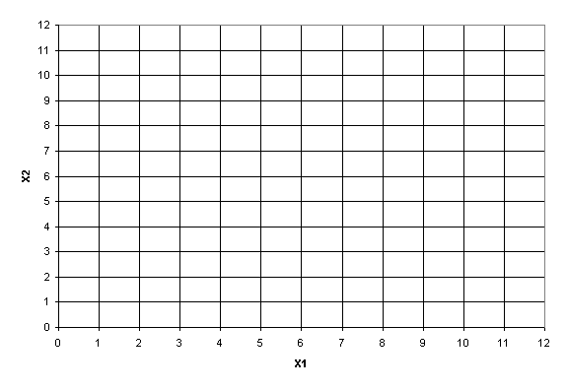
Example 3:
Graph the data from example 2 and find the rates of change by looking at a graph.
Year | 1988 | 1990 | 1991 | 2004 | 2008
Cost (cents) | 25 | 25 | 29 | 37 | 42
55
50
45
40
35
30
25
20
15
10
5
0
1988 1992 1996 2000 2004 2008
Year

Slide 9
Example 3:
Graph the data from example 2 and find the rates of change by looking at a graph.
From 1988 – 1990 → Goes up zero cents over 2 years. 0/2 = 0 cents per year.
From 1990 – 1991 → Goes up 4 cents over 1 years. 4/1 = 4 cents per year.
From 1991 – 2004 → Goes up 8 cents over 13 years. 8/13 = 0.62 cents per year.
From 2004 – 2008 → Goes up 5 cents over 4 years. 5/4 = 1.25 cents per year.
55
50
45
40
35
30
25
20
15
10
5
0
The steepness of the lines demonstrate the rates of change.
1988 1992 1996 2000 2004 2008
Year

Slide 10
Slope
The word slope (gradient, incline, pitch) is used to describe the measurement of the steepness of a straight line.
The slope of a line is also known as the rate of change.
Notes:
10

Slide 11
Rate of Change of a Linear Relationship
run
rise
Rate of Change =

Slide 12
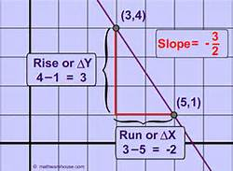
Slope is a ratio and can be expressed as:
Vertical Change or Rise or Change in y Horizontal Change Run Change in x
Notes:
12

Slide 13
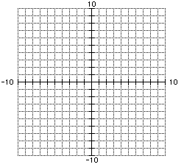
Is the slope positive or negative?
P₂(x₂, y₂)
Positive
Vertical change = 14
Slope = vertical change
horizontal change
P₁(x₁, y₁)
Slope = 14/ 7
=2
Horizontal change = 7
Notes:
13

Slide 14
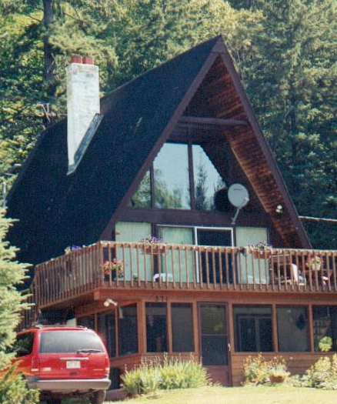
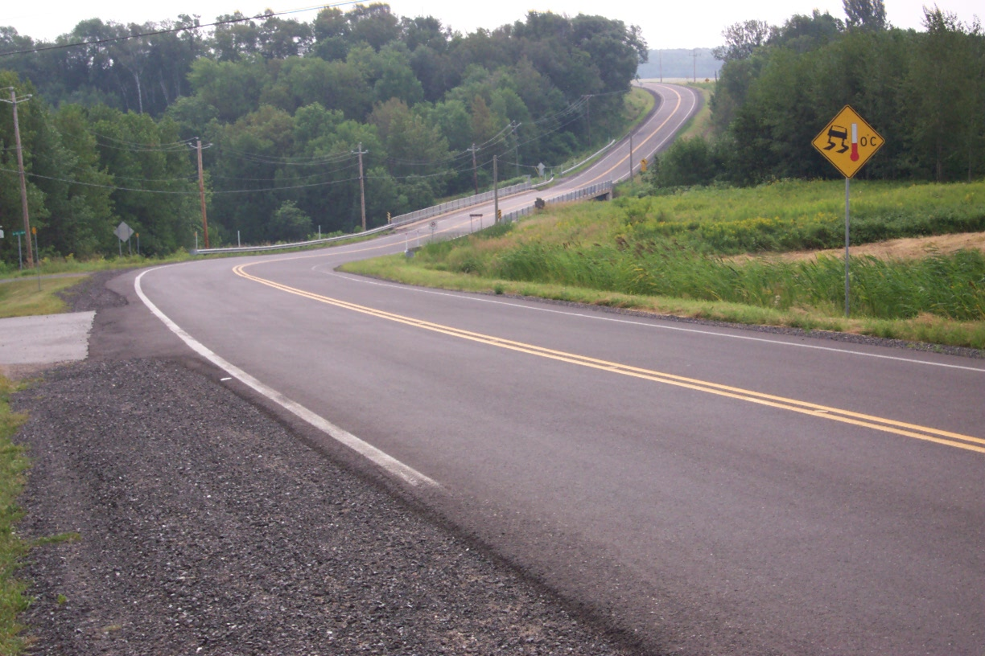
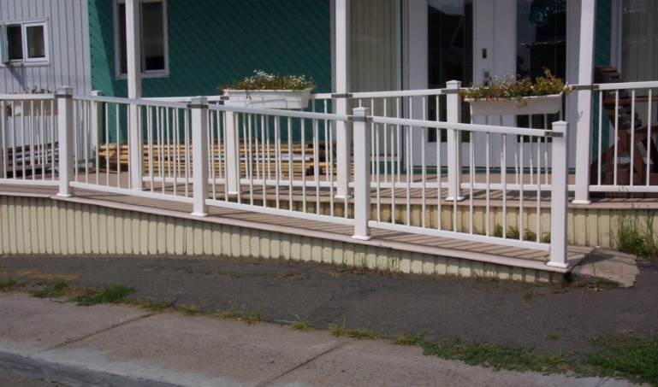
Rates of change are seen everywhere.

Slide 15
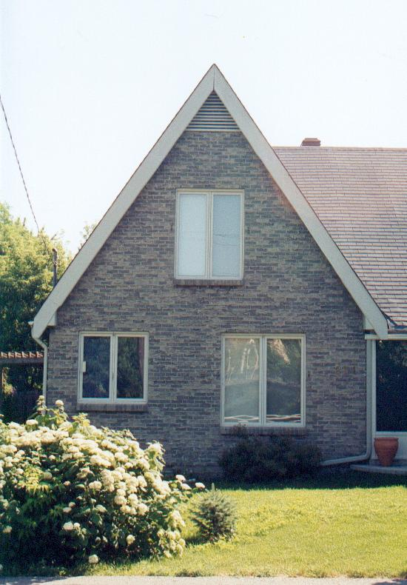
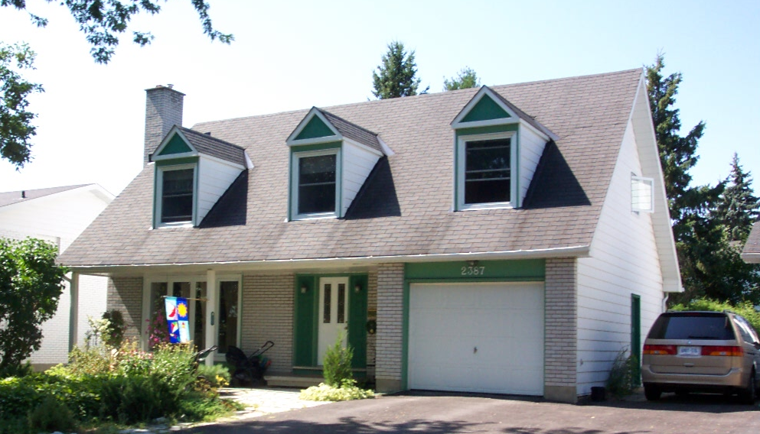
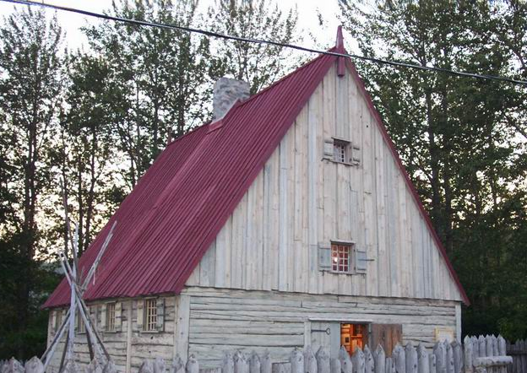
The steepness of the roof of a house.

Slide 16
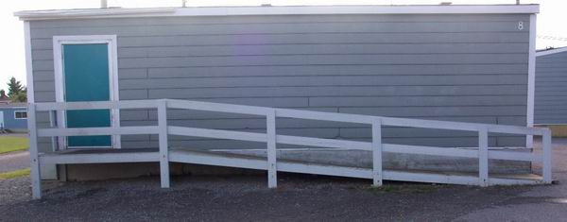
The steepness of wheelchair ramps is of great importance for safety.
1
12
Average rate of change of any wheelchair ramp =
If the rise is 1.5 m, what is the run?
Answer: 18 m because

Slide 17
Determine the average rate of change of the roof.
3 m
5 m

Slide 18
Determine the average rate of change of each staircase.
3
2
3
3

Slide 19
Homework:
4.3 Homework #1 – Rates of Change and Slope

Slide 20
Find the slope between (-3, 6) and (5, 2)
y-axis
(-3, 6)
(5, 2)
x-axis
Rise
-4
-1
=
=
Run
8
2

Slide 21
Find the slope between (5, 4) and (5, 2).
y
x
Rise
-2
Undefined
=
=
Run
0

Slide 22
Find the slope between (5, 4) and (-3, 4).
y
x
Rise
0
Zero
=
=
Run
-8

Slide 23
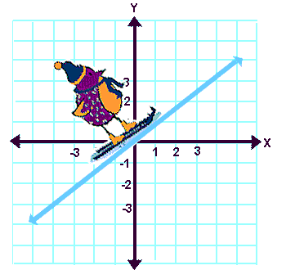
Types of Slopes
Positive Slope
m = +
Notes:
23

Slide 24
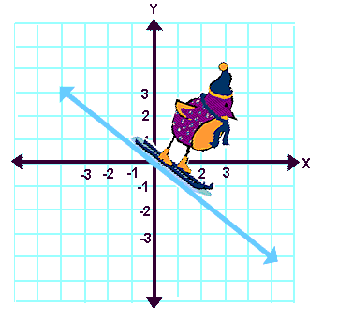
Types of Slopes
Negative Slope
m = -
Notes:
24

Slide 25
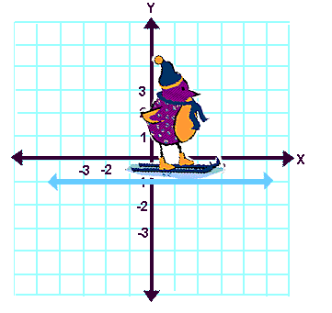
Types of Slopes
Horizontal lines have zero slope:
m = 0
Notes:
25

Slide 26
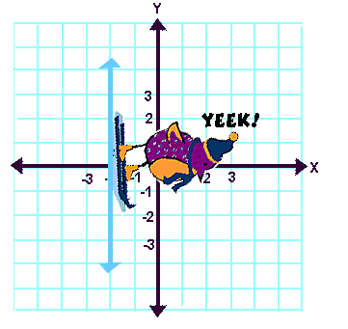
Types of Slopes
Vertical lines have no slope or an undefined slope.
Notes:
26

Slide 27
Example 4: Real Life Slope Problem
The maximum recommended slope of a wheelchair ramp is 1/12.
A business is installing a wheelchair ramp that rises 22 inches over a horizontal length of 24 feet.
Is the ramp steeper than recommended?

Slide 28
Is the ramp steeper than the recommended 1/12?
The horizontal length is 12(24) = 288 inches.
Therefore the slope is: Vertical Change
Horizontal Change
= 22 in
288 in
≈ 0.076 < 0.083 = 1/12
The slope is
not steeper
than recommended
22 in
24 ft
= 288 in

Slide 29
Exit Ticket: (5 minutes)
Would you rather climb a hill with a slope of 4 or a hill with a slope of 5/2? Explain your answer.

Slide 30
Homework:
4.3 Homework #2: Rates of Change and Slope

