Slide 1
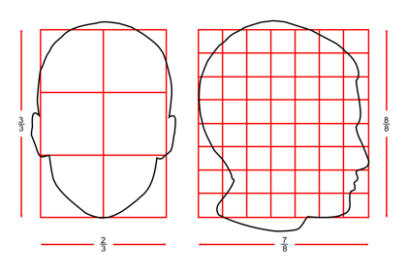
Rates, Ratios, and Proportions
Section 1.8

Slide 2
Objectives:
Write and use ratios, rates, and unit rates.
Write and solve proportions.

Slide 3
Classwork:
Exploration:
Rates, Ratios, and Proportions

Slide 4
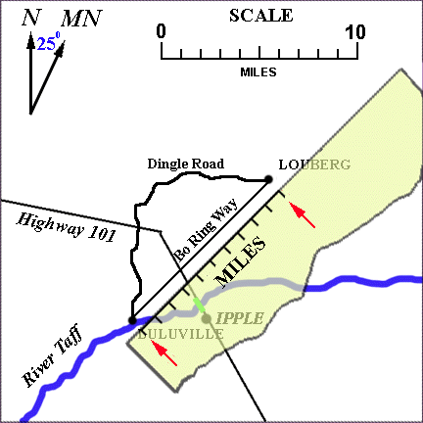
Random Fact: Why learn this?
Ratios and Proportions are used to draw accurate maps.

Slide 5
Definition:
A ratio is a comparison of two quantities by division.
The ratio of a to b can be written as a:b or $\frac{a}{b}$, where b≠0.
Ratios of the same comparison are called equivalent.
A statement that two ratios are equivalent is called a proportion.
Example: $\frac{1}{2}=\frac{2}{4}$

Slide 6
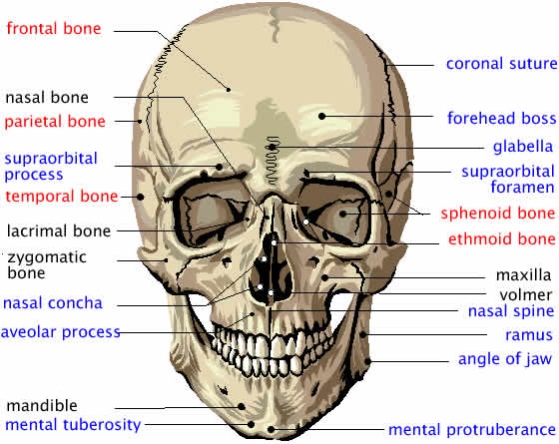
Example 1:
The ratio of the number of bones in the human skull to the number of bones in the ears is 11:3.
There are 22 bones in the skull.
How many bones are in the ears?
$$\frac{ears}{skull}→\frac{3}{11}$$
Write a proportion and solve.
$$\frac{3}{11}=\frac{x}{22}$$
$22·\frac{3}{11}=\frac{x}{22}$·22
x = 6 bones

Slide 7
Definition:
A rate is a ratio of two quantities with DIFFERENT units.
Example: $\frac{34 miles}{2 gallons}.$
A unit rate has the second quantity as one unit.
Example:$\frac{17 miles}{1 gallon}$or 17miles/gallon
You can convert any rate to a unit rate by division.

Slide 8
Example 2:
Takeru Kobayashi of Japan ate 53.5 hot dogs in 12 minutes to win a contest.
Find the unit rate in hot dogs per minute.
$$\frac{53.5 hot dogs}{12 minutes}$$
4.46 hot dogs per minute

Slide 9
Definitions:
Dimensional analysis is a process that uses rates to convert measurements from one unit to another.
A conversion factor is a rate in which the two quantities are equal, but use different units.
Example: $\frac{12 inches}{1 foot}$.
To convert from one set of units to another, multiply by the conversion factor.

Slide 10
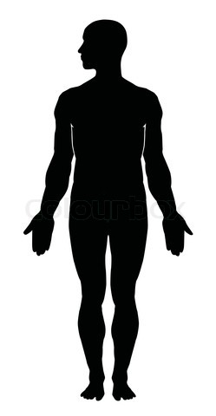
Example 3:
A large adult male human has about 12 pints of blood.
Use dimensional analysis to convert this quantity to gallons.
First, convert pints to quarts.
12 pints · $\frac{1quart}{2pints}$
= 6 quarts
Second, convert quarts to gallons.
6 quarts · $\frac{1gallon}{4quarts}$
= 1.5 gallons.
A large adult male human has about 1.5 gallons of blood.

Slide 11
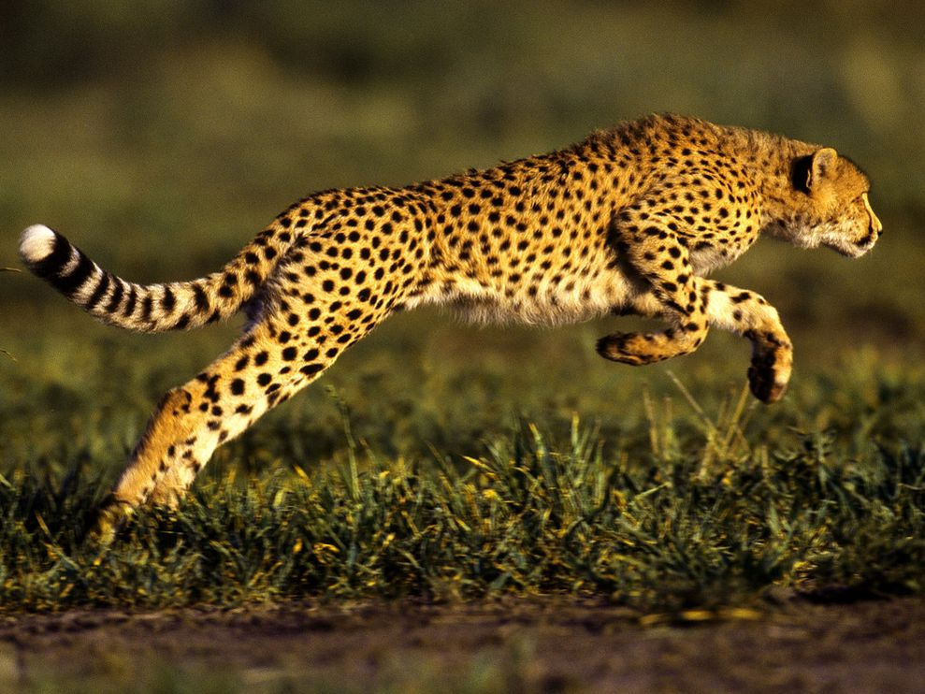
Example 4:
A cheetah can run at a rate of 60 miles per hour.
What is this speed in feet per minute?
Use the conversion factors:
5280 feet/1 mile and 1 hour/60 minutes
$\frac{60miles}{1hour}$·$\frac{5280feet}{1mile}$·$\frac{1hour}{60minutes}$
= 5280 feet/minute

Slide 12
Homework:
1.8 Exercises
Examples: 1 – 9, 11, 12, 20 – 26, 39

Slide 13
Cross Products Property:
In the proportion $\frac{a}{b}=\frac{c}{d}$, the products a·d = b·c are called cross products.
In a proportion, cross products are equal.

Slide 14
Example 5:
Solve each proportion.
a) $\frac{3}{9}=\frac{5}{m}$
45 = 3m
m = 15
b) $\frac{6}{y−3}=\frac{2}{7}$
42 = 2y – 6
48 = 2y
y=24

Slide 15
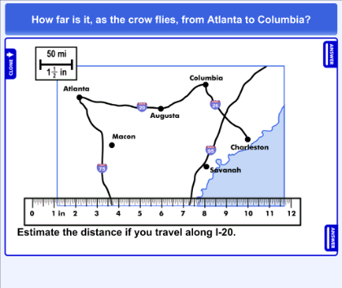
Definition:
A scale is a ratio between two sets of measurements.
Example: 1 in : 5 mi
A scale drawing or scale model uses a scale to represent an object as smaller or larger than the actual objects.
A map is an example of a scale drawing.

Slide 16
Example 6:
On a road map, the distance between Pittsburgh and Philadelphia is 7.5 inches.
What is the actual distance between the cities if the map scale is 1.5 inches = 60 miles?
Let d be the actual distance between the cities.
1.5
60
=
7.5
d
Write a proportion.
1.5 · d = 60 · 7.5
Find the cross products.
1.5d = 450
Multiply.
d = 300
Divide.
The distance between the cities is 300 miles.

Slide 17
Example 7:
A contractor has a blueprint for a house drawn to the scale 1 in:3 ft.
a) A wall on the blueprint is 6.5 inches. How long is the actual wall?
$$\frac{blueprint}{wall}→\frac{6.5}{w}=\frac{1}{3}$$
1(w) = 6.5(3)
w = 19.5
The length of the actual wall is 19.5 ft.

Slide 18
Example 7:
A contractor has a blueprint for a house drawn to the scale 1 in:3 ft.
b) One wall of the house will be 12 ft long. How long is the wall on the blueprint?
$$\frac{blueprint}{wall}→\frac{b}{12}=\frac{1}{3}$$
3(b) = 12(1)
3b = 12
b = 4
The length of the blueprint wall is 4 inches.

Slide 19
Exit Ticket (5 minutes)
Explain two ways to solve the proportion:
$$\frac{t}{4}=\frac{3}{5}$$

Slide 20
Homework:
1.8 Additional Practice Worksheet

