Slide 1
Relations and Functions
Section 3.2

Slide 2
Objectives:
Identify functions.
Find the domain and range of relations and functions.

Slide 3
Classwork:
Exploration: Relations and Functions

Slide 4
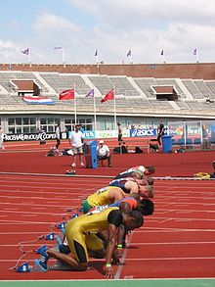
Random Fact: Why learn this?
You can use a relation to show finishing positions and scores in a track meet.

Slide 5

First, let’s talk about relations
Notes:
Define the relationships that are presented.
Husband and Wife
Father and son
Foot length shoe size
Number of drinks and BAC

Slide 6

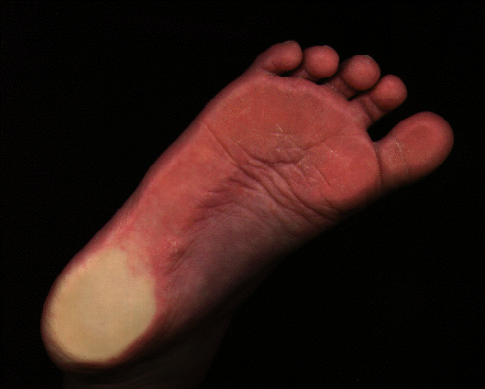
Relations
Notes:
Define the relationships that are presented.
Husband and Wife
Father and son
Foot length shoe size
Number of drinks and BAC

Slide 7
Relations
(A)
(B)
(C)
32 mpg
8 mpg
16 mpg
Notes:
Match the miles per gallon to the vehicle
Write the definition of RELATION:
“The way one thing is related to another, to reference to or connection with”
“A set of ordered pairs”
What is meant by “Ordered pairs”
Which is causing which?
The miles per gallon causes the vehicle size
The vehicle size causes the miles per gallon
The “independent” variable causes the “dependent” variable (in most cases)

Slide 8
Many things are related:
Think about things in the world that relate two quantities by some rule…

Slide 9
Area of a Circle relates to its Radius
A = πr²

Slide 10

The distance d traveled on a bike in 2 hours is related to the speed s
d = 2s

Slide 11

However, not all relations have simple math formulas…
Example:
Hours of the day with temperature...
Can you think of a simple equation???

Slide 12
However, there is still some rule that matches each item from one set with exactly one item from a different set.

Slide 13
Relations:
A Relation is a set of ordered pairs.
The set of the first coordinates (or x-values) is called the domain of the relation.
The set of the second coordinates (or y-values) is called the range of the relation.

Slide 14
Domain
Range
Correspondence
or
Relation

Slide 15
Relations
x | y
-4 | 5
-2 | 6
0 | 2
Domain: {-4, -2, 0}
Range: {5, 6, 2}

Slide 16
Example 1:
Given the relation
{(-4, 3), (-1, -2), (0, -4), (2, 3), (3, -3)}
What is the domain?
{-4, -1, 0, 2, 3}
What is the range?
{3, -2, -4, -3},
(note it is not required list a number twice)

Slide 17
Example 2:
Express the relation for the track meet scoring system as a table, a graph, and a mapping diagram.
{(1, 5), (2, 3), (3, 2), (4, 1)}
The domain = place
{1, 2, 3, 4}
The range = number of points
{5, 3, 2, 1}

Slide 18
Example 2:
Table:
{(1, 5), (2, 3), (3, 2), (4, 1)}
Track Scoring
Place | Points
1 | 5
2 | 3
3 | 2
4 | 1

Slide 19
Example 2:
Graph:
{(1, 5), (2, 3), (3, 2), (4, 1)}
Track Scoring
5
4
3
2
1
0 1 2 3 4 5
Points
Place

Slide 20
Example 2:
Mapping Diagram:
{(1, 5), (2, 3), (3, 2), (4, 1)}
Track Scoring
Place
1
2
3
4
Points
5
3
2
1

Slide 21
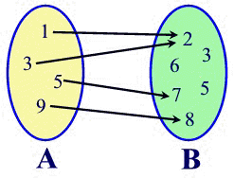
Example 3:
Give the domain and range of the relation.
a)
Domain: {1, 3, 5, 9}
Range: {2, 7, 8}

Slide 22
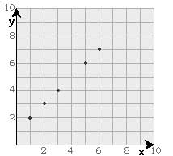
Example 3:
Give the domain and range of the relation.
b)
Domain: {1, 2, 3, 5, 6}
Range: {2, 3, 4, 6, 7}

Slide 23
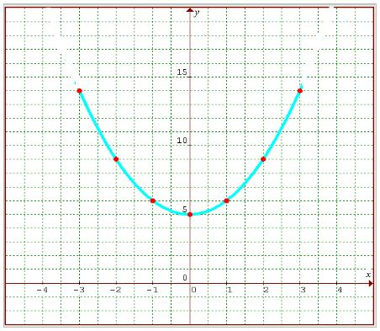
Example 3:
Give the domain and range of the relation.
c)
Domain: -3 ≤ x ≤ 3
Range: 5 ≤ y ≤ 14

Slide 24
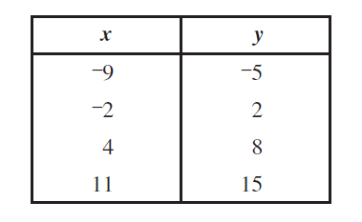
Example 3:
Give the domain and range of the relation.
d)
Domain: {-9, -2, 4, 11}
Range: {-5, 2, 8, 15}

Slide 25
Homework:
3.2 Homework: Relations, Domain, and Range

Slide 26
Functions
A function f is a relation that pairs each domain value with exactly one range value.
There is one and only one output (y) for each input (x).
f(x)
y
x

Slide 27
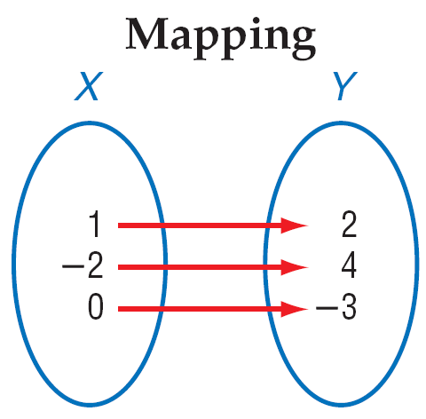
Mapping
In a function, each member of the domain is paired with ONE member of the range

Slide 28
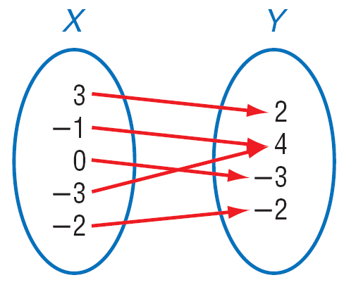
Another example of a function:
Given the mapping:
What is the domain?
{3, -1, 0, -3, -2}
What is the range?
{2, 4, -3, -2}

Slide 29
Types of Functions
1. One-to-One
Each element of the range is paired with exactly one element of the domain

Slide 30
2. Not One-to-One Function

Slide 31
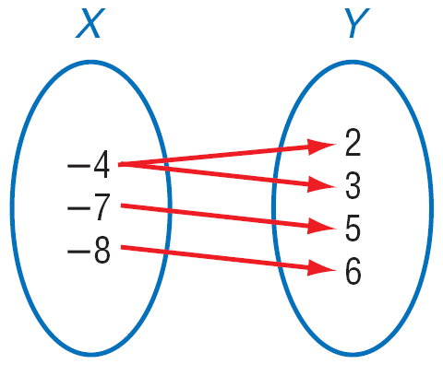
3. Not a Function
The domain value is paired with more than one range value

Slide 32
Example 4:
a) Decide if the relation is a function.
X Y
1 2
-5 7
-1 2
3 3
X Y
1 1
-5 1
-1 1
3 1
X Y
1 2
1 7
1 2
1 3
X Y
1 π
π 1
-1 5
π 3

Slide 33
Example 4: b) Decide if the relation is a function.
{(1,3), (2,3), (3,3)}
Yes
No

Slide 34
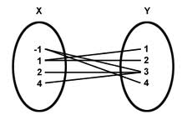
Example 4:
c) Decide if the relation is a function.
Nope

Slide 35
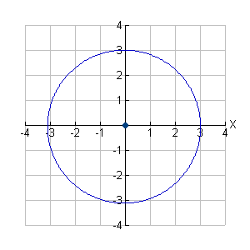
Example 4:
d) Decide if the relation is a function.
Nope

Slide 36
Example 5: Are the following functions?
The relation is the year and the cost of apples.
No
The relation is a number and it’s square.
Yes
Notes:
This is one place the real world and math don’t mix very well. In most cases the real world works in the set of rational numbers. In fact, we round off most irrationals to rational to be able to work with them. Yet in mathematics, the definition of your domain and range in a sense defines the relation. For two relations to be equivalent they must have the same set of ordered pairs. That is each element in the domain must be matched with the exact same element in the range. For example, the square root of x squared is equivalent to the absolute value of x.

Slide 37
Collins Writing
Are the relations functions?
EXPLAIN your answers
The relation is the weight of person and the beats per minute of his heart.
The relation is the time of the day and the intensity of the sun light.
The relation is the time since you left your house for work and your distance away from home.
Notes:
This is one place the real world and math don’t mix very well. In most cases the real world works in the set of rational numbers. In fact, we round off most irrationals to rational to be able to work with them. Yet in mathematics, the definition of your domain and range in a sense defines the relation. For two relations to be equivalent they must have the same set of ordered pairs. That is each element in the domain must be matched with the exact same element in the range. For example, the square root of x squared is equivalent to the absolute value of x.

Slide 38
Homework:
Relations and Functions Worksheet #1

Slide 39
Classwork:
3.2 Algebra Lab – The Vertical Line Test

Slide 40
Homework:
Relations and Functions Worksheet #2

