Slide 1
Section 3.5
Scatter Plots and Trend Lines

Slide 2
Objectives:
Create and interpret scatter plots.
Use trend lines to make predictions.

Slide 3
Classwork:
3.5 Exploration
Scatterplots and Trend Lines

Slide 4
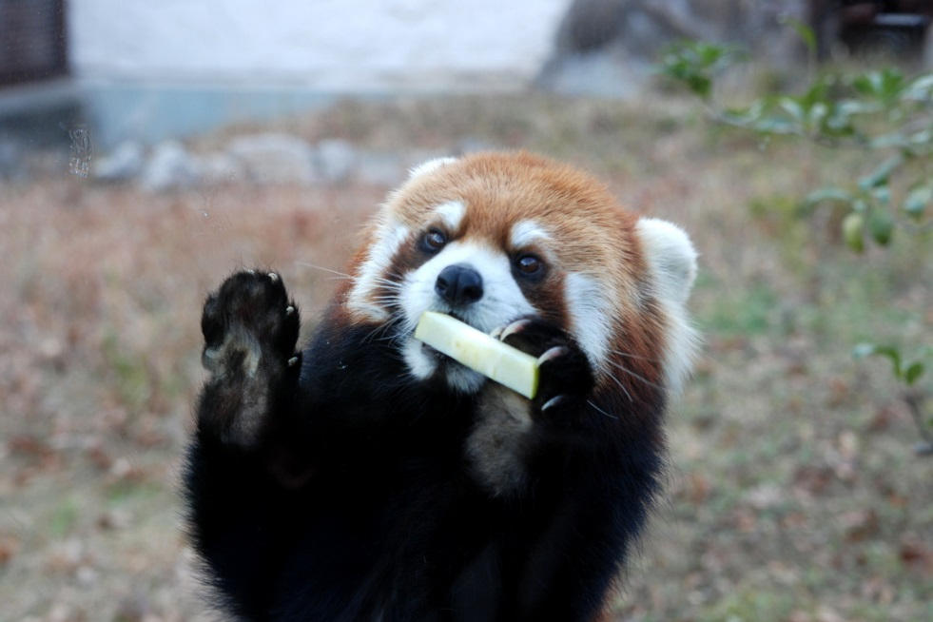
Random Fact: Who uses this?
Ecologists can use scatter plots to help them analyze data about endangered species, such as red pandas.

Slide 5
Do Now (5 minutes):
Write down examples of real world situations that describe a relationship between two variables. What type of trends, if any, might you see?
Example to get you started:
Your age and height.
There is an increasing trend. As your age increases, your height increases.

Slide 6
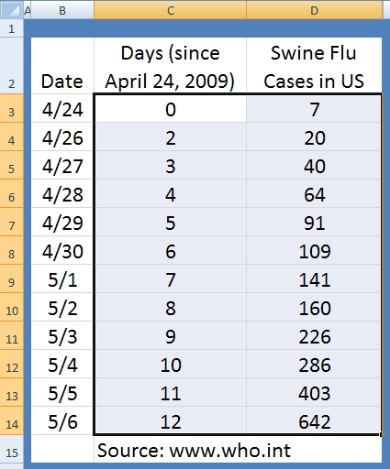
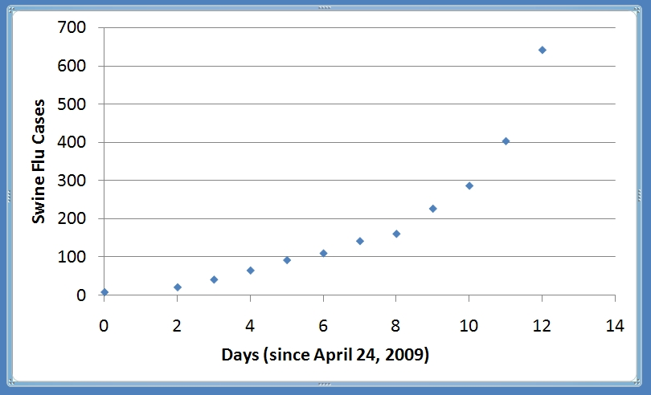
A scatter plot is a graph of a collection of ordered pairs (x,y).
Notes:
6

Slide 7
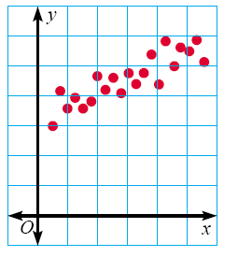
Positive Correlation
If the x-coordinates and the y-coordinates both increase, then it is POSITIVE CORRELATION.

Slide 8
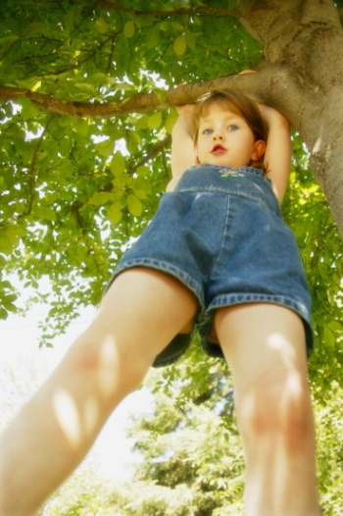
Positive Correlation
Age vs. Height
As the child gets older, the child gets taller.
Because both are going up, it is positive correlation.
Age | 1 | 2 | 3 | 4 | 5 | 6 | 7 | 8
Height in inches | 25 | 31 | 34 | 36 | 40 | 41 | 47 | 55

Slide 9
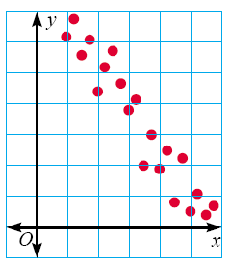
Negative Correlation
If the x-coordinates and the y-coordinates have one increasing and one decreasing, then it is NEGATIVE CORRELATION.

Slide 10

Negative Correlation
Age of Family Car vs. Value
As the car gets older, the car is worth less.
This is negative correlation.
Age of car | 1 years | 2 years | 3 years | 4 years | 5 years
Value | $30,000 | $27,000 | $23,500 | $18,700 | $15,350

Slide 11
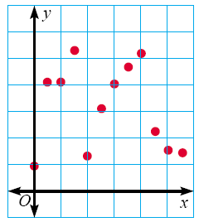
No Correlation
If there is no pattern, and the points looked scattered, then it is NO CORRELATION.

Slide 12
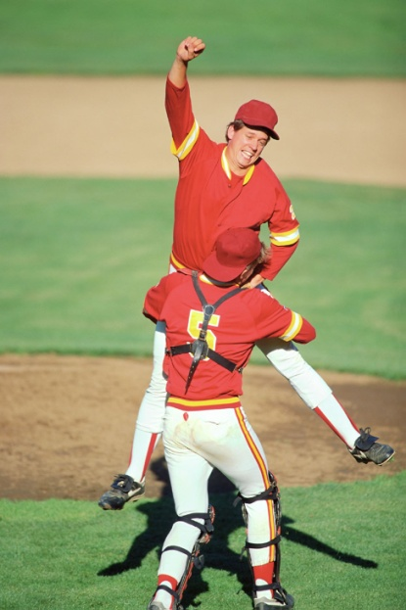
No Correlation
Shoe Size vs. Batting Average
The shoe size does not make the player better or worse.
This has no correlation.

Slide 13
Scatterplots
Which scatterplots below show a linear trend?
a)
c)
Negative
Correlation
e)
Positive
Correlation
b)
d)
f)
Constant
Correlation

Slide 14
Example 1:
Identify the type of correlation you would expect to see between each pair of data sets. Explain.
a) The average temperature in a city and the number of speeding tickets given in the city.
No Correlation
b) The number of people in an audience and ticket sales.
Positive Correlation
c) The time since the start of a race and a runner’s distance to the finish line.
Negative Correlation

Slide 15
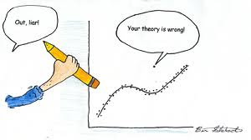
An outlier is a point of the scatterplot that doesn’t fit the trend.
Sometimes statisticians omit these points when studying data.

Slide 16
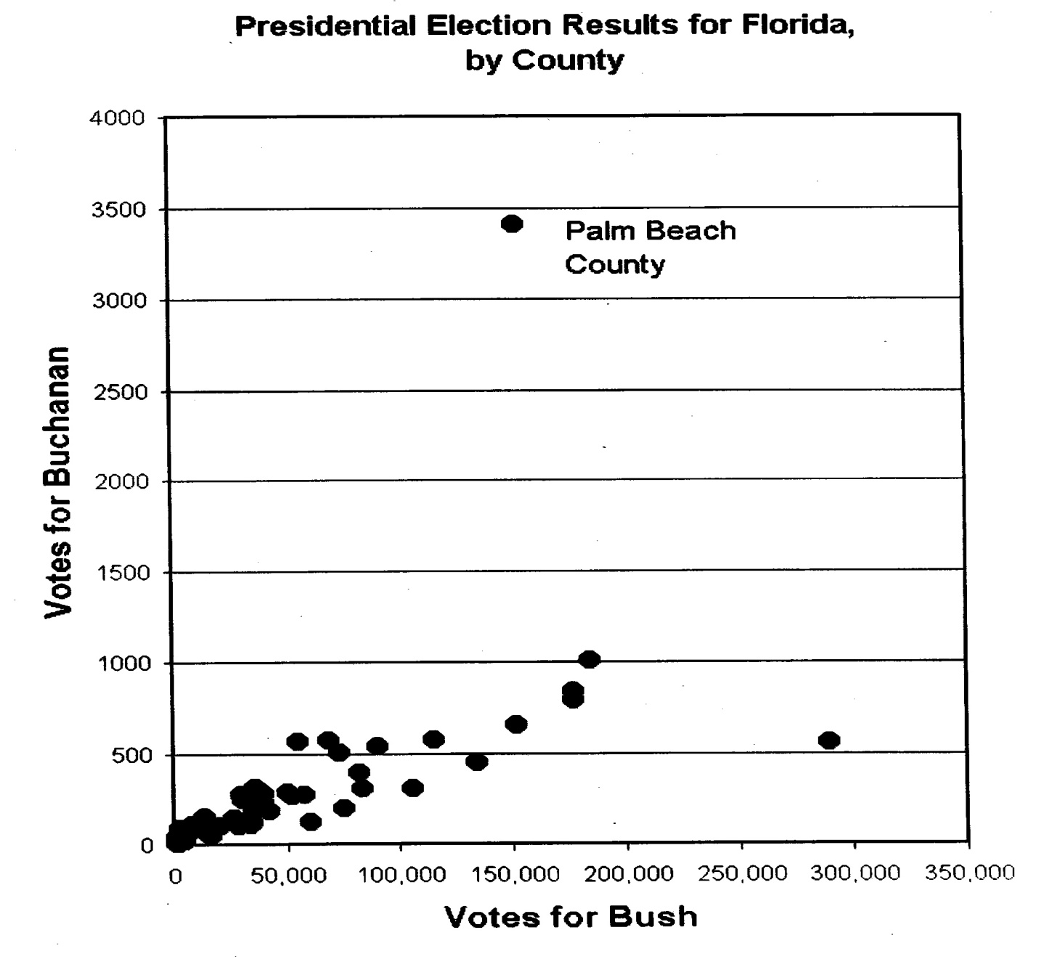
2000 Presidential Election

Slide 17
Homework:
Scatterplots Worksheet #1

Slide 18
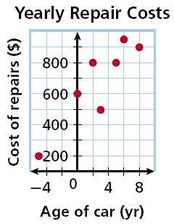
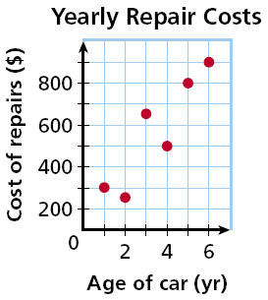
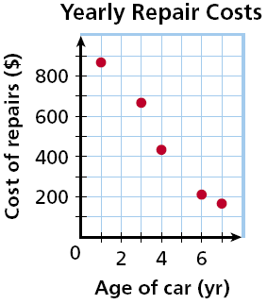
Example 2:
Choose the scatter plot that best represents the relationship between the age of a car and the amount of money spent each year on repairs. Explain.
Graph A
Graph B
Graph C

Slide 19
Example 2:
Graph A
The age of the car cannot be negative.
This is incorrect

Slide 20
Example 2:
Graph B
This graph shows all positive values and a positive correlation, so this graph could be correct!

Slide 21
Example 2:
Graph C
There will be a positive correlation between the amount spent on repairs and the age of the car.
Graph C shows a negative correlation, so it is incorrect.

Slide 22
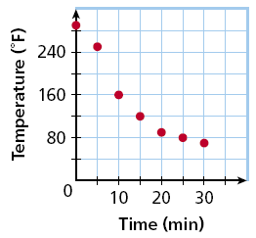
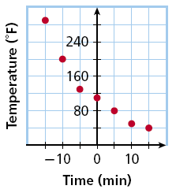
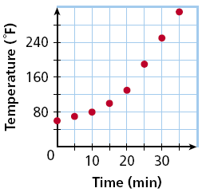
Example 3: ON YOUR OWN
Choose the scatter plot that best represents the relationship between the number of minutes since an oven was turned off and the temperature of the oven. Explain.
Graph A
Graph B
Graph C

Slide 23
Example 3:
Graph A
Answer: Graph A
There will be a negative correlation between the time and the temperature because oven will get cooler as it is turned off.

Slide 24
Trend Lines
The trend line is the straight line that fits closest to the data.
It may go through some, or none of the points.
Try to have the same amount of points above and below the line.
Trend lines can help us make predictions.
They also show us the correlation more clearly.

Slide 25
Example 4: Plot the data on homework time and TV time on the graph
TV
Homework
240
210
180
150
120
90
60
30
30 min.
180 min.
45 min.
150 min.
120 min.
90 min.
Time on
Homework
240 min.
30 min.
90 min.
120 min.
150 min.
120 min.
180 min.
90 min.
30 90 150 210
60 120 180 240
Time Watching TV

Slide 26
Now draw the trend line and describe any trends
Trend appears linear.
240
210
180
150
120
90
60
30
Trend is decreasing.
Time on
Homework
Negative correlation.
30 90 150 210
60 120 180 240
Time Watching TV

Slide 27
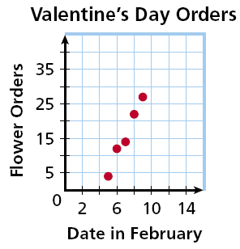
Example 5:
The scatter plot shows the number of orders placed for flowers before Valentine’s Day at one shop.
Using a trend line, predict the number of flower orders placed on February 12.
about 45

Slide 28
Homework:
Scatterplots Worksheet #2

Slide 29
Regression Lines!
Now… We are going to find trend lines on the graphing calculator to help us make predictions…

Slide 30
Finding the Solution: TI-83/84
Using the TI- 83/84 graphing calculator
  Enter the data.
  Graph a scatterplot of the data.
  Find the equation of the trend line.
  Graph the trend line on the graph with the scatterplot.

Slide 31
Example 6:
Temperature (F)
Water Consumption (ounces)
For seven
random summer days, a person recorded the temperature and their water consumption.
75
16
83
20
85
25
85
27
92
32
97
48
99
48
Notes:
(The data is shown in the table with the temperature placed in increasing order.)

Slide 32
Example
Now you want to plan an outdoor party.
Predict the amount of
water a person would drink when the temperature is 95 degrees F.
Notes:
If you were planning an outdoor party in the summer time, you might need to estimate how many soft drinks to buy. In your planning, you will, of course, need to know how many people will be attending. However, as you determine the number of soft drinks for each person, you might want to also consider how hot it will be. The temperatures have been forecasted for around 95 degrees on the day of the outdoor party. (In real life, you would probably make an estimate based on your previous experience and make a logical increase based on the temperature.) We will use some hypothetical data to determine how thirsty people might be. We will use the Temperature/Water example data for this.

Slide 33
1. Enter the Data into Lists
Press STAT.
Under EDIT, select 1: Edit.
Enter x-values (input) into L1
Enter y-values (output) into L2.
Note: If you need to clear out a list, for example list 1, place the cursor on L1 then hit CLEAR and ENTER .

Slide 34
2. Set up the Scatterplot.
Press 2nd Y= (STAT PLOTS).
Select 1: PLOT 1 and hit ENTER.
Move the cursor to On and hit ENTER.
Move the cursor to Type: and select the first graph under Type.
Under Xlist: Enter L1.
Under Ylist: Enter L2.
Under Mark: select any of these.

Slide 35
3. View the Scatterplot
To plot the points, press ZOOM and select 9: ZoomStat.
The scatterplot will then be graphed.

Slide 36
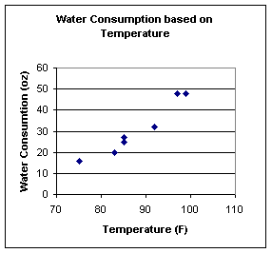
Example
Temperature (F)
Water Consumption (ounces)
75
16
83
20
85
25
85
27
92
32
97
48
99
48

Slide 37
The Graph
We will now find the “trend line” called the REGRESSION LINE on your calculator.

Slide 38
4. Find the regression line.
Press STAT.
Press CALC.
Select 4: LinReg(ax + b).
Press ENTER.

Slide 39
5. Interpreting and Visualizing
Interpreting the result:
y = ax + b
  The value of a is 1.451162791
The value of b is – 96.84518272

Slide 40
5. Interpreting and Visualizing
Write down the equation of the line:
y = 1.451162791x – 96.84518272
Press Y= and enter the equation under Y1. (Clear all other equations.)
Press GRAPH and the line will be graphed through the data points.

Slide 41
Interpretation in Context
Regression Equation:
y = 1.451162791x – 96.84518272
  Water Consumption = 1.451162791(Temperature) – 96.84518272

Slide 42
Prediction Example
Predict the amount of
water a person would drink when the temperature is 95 degrees F.
Solution:
y = 1.451162791(95) – 96.84518272
= 41.01528243 ounces.
Notes:
Solution: Substitute the value of x=95 (degrees F) into the regression equation y=1.5*x - 96.9 and solve for y (water consumption).
y=1.5*x - 96.9
if x=95, then y=1.5*95 - 96.9 = 45.6 ounces.
Note: Since 95 degrees F is in the range of values that were used to find the regression equation, then we can use this equation to predict the water consumption. If the desired prediction had been for 50 degrees F, then the model should not be used, since the value of x does not fall in the range of predictability for this model.

Slide 43
Classwork:
Section 3.5 Technology Lab:
Practice with Trend Lines/Linear Regression

