Slide 1
Solving Absolute-Value Equations
Section 1.7

Slide 2
Objective
Solve equations in one variable that contain absolute value expressions.

Slide 3
Classwork:
Exploration:
Solving Absolute-Value Equations

Slide 4
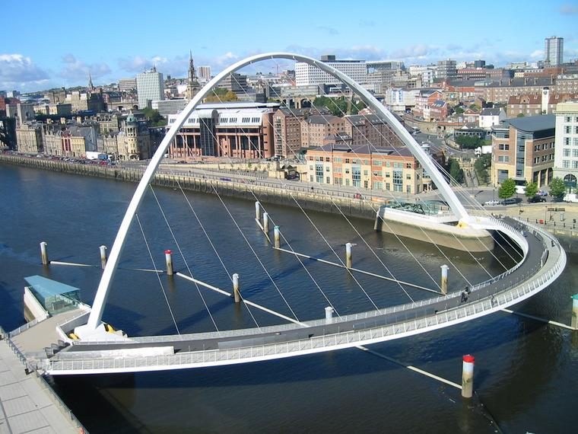
Random Fact: Why learn this?
Engineers can solve absolute-value equations to calculate the length of the deck of a bridge.

Slide 5
Absolute value is denoted by the bars |3|.
Absolute value represents the distance a number is from 0.
It is always positive.
|8| = 8 and |-8| = 8

Slide 6
Solving absolute value equations
First, isolate the absolute value expression.
Set up two equations to solve.
For the first equation, drop the absolute value bars and solve the equation.
For the second equation, drop the bars, make the opposite side negative, and solve the equation.
Always check the solutions!!!!!!!!!!!!!!!!!

Slide 7
Example 1: Solve 6|5x + 2| = 312
Isolate the absolute value expression by dividing by 6.
6|5x + 2| = 312
|5x + 2| = 52
Set up two equations to solve.
5x + 2 = 52 5x + 2 = -52
5x = 50 5x = -54
x = 10 or x = -10.8
Check: 6|5x + 2| = 312 6|5x + 2| = 312
6|5(10)+2| = 312 6|5(-10.8)+ 2| = 312
6|52| = 312 6|-52| = 312
312 = 312 312 = 312

Slide 8

Example 2:
Solve each equation.
a) $\left|x\right|=4$
x = 4 x = -4

Slide 9

Example 2:
Solve each equation.
$4\left|x+2\right|=24$
$$\left|x+2\right|=6$$
x + 2 = 6 x + 2 = -6
x = 4 x = -8

Slide 10

Example 2:
Solve each equation.
c) $3\left|x+7\right|=24$
$$\left|x+7\right|=8$$
x + 7 = 8 x + 7 = -8
x = 1 x = -15

Slide 11
Example 3: Solve 3|x + 2| -7 = 14
Isolate the absolute value expression by adding 7 and dividing by 3.
3|x + 2| -7 = 14
3|x + 2| = 21
|x + 2| = 7
Set up two equations to solve.
x + 2 = 7 x + 2 = -7
x = 5 or x = -9
Check: 3|x + 2| - 7 = 14 3|x + 2| -7 = 14
3|5 + 2| - 7 = 14 3|-9+ 2| -7 = 14 3|7| - 7 = 14 3|-7| -7 = 14
21 - 7 = 14 21 - 7 = 14
14 = 14 14 = 14

Slide 12
Homework:
1.7 Exercises:
Examples: 14 – 23

Slide 13
Note!
Not all absolute value equations have two solutions.
The absolute value of zero has one solution, zero!
If the absolute value equals a negative, there is no solution.

Slide 14

Example 4:
Solve each equation.
a) $\left|x+3\right|+4=4$
$$\left|x+7\right|=0$$
x + 7 = 0
x = -7

Slide 15
Example 4:
Solve each equation.
b) $3+\left|x+4\right|=0$
$$\left|x+4\right|=−3$$
Cannot be negative
No Solution

Slide 16
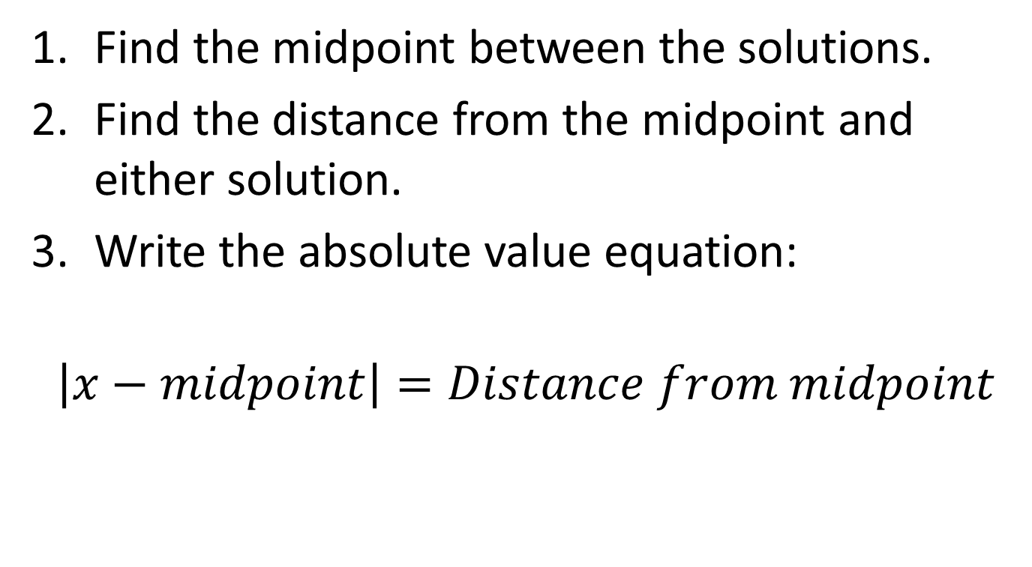
Writing an Absolute value equation when you know the solutions.
Find the midpoint between the solutions.
Find the distance from the midpoint and either solution.
Write the absolute value equation:
$$\left|x−midpoint\right|=Distance from midpoint$$

Slide 17
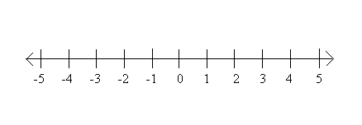
Example 5:
Write an absolute value equation whose solutions are graphed.
a)
Midpoint = 0
Distance from midpoint = 3
$$\left|x−midpoint\right|=Distance from midpoint$$
$$\left|x−0\right|=3$$
$$\left|x\right|=3$$

Slide 18
Example 5:
Write an absolute value equation whose solutions are graphed.
b)
Midpoint = -1
Distance from midpoint = 4
$$\left|x−midpoint\right|=Distance from midpoint$$
$$\left|x−−1\right|=4$$
$$\left|x+1\right|=4$$

Slide 19
Example 5:
Write an absolute value equation whose solutions are graphed.
c)
Midpoint = 2
Distance from midpoint = 3
$$\left|x−midpoint\right|=Distance from midpoint$$
$$\left|x−2\right|=3$$

Slide 20
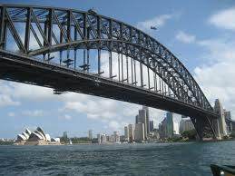
Example 6:
Sydney Harbour Bridge in Australia is 1149 meters long.
Because of temperatures, the bridge can expand or contract by as much as 420 millimeters.
Write and solve an absolute value equation to find the minimum and maximum lengths of the bridge.
Solution:
Convert millimeters to meters.
420 mm = 0.42 meters.
Midpoint = 1149
Distance from midpoint = 0.42
$$\left|x−midpoint\right|=Distance from midpoint$$
$$\left|x−1149\right|=0.42$$
Now solve…

Slide 21
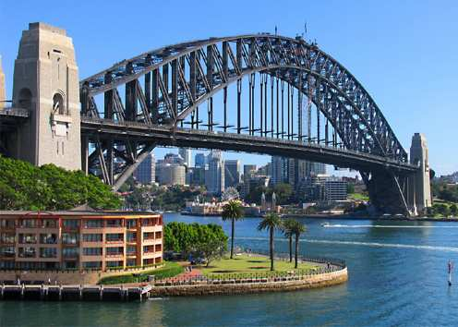
Example 6:
$$\left|x−1149\right|=0.42$$
x – 1149 = 0.42 x – 1149 = -0.42
x = 1149.42 x = 1148.58
The minimum is 1148.58m and the maximum is 1149.42m

Slide 22
Exit Ticket (5 minutes)
On a separate piece of paper:
DESCRIBE the steps you would use to solve
$$\frac{1}{5}\left|x−3\right|=2$$
(We will share these with the class and I will collect this for a classwork grade)

Slide 23
Homework:
1.7 Additional Practice Worksheet

