Slide 1
Solving Absolute-Value Inequalities
Section 2.7

Slide 2
Objective:
Solve inequalities in one variable involving absolute-value expressions.

Slide 3
Classwork:
Exploration: Solving Absolute-Value Inequalities

Slide 4
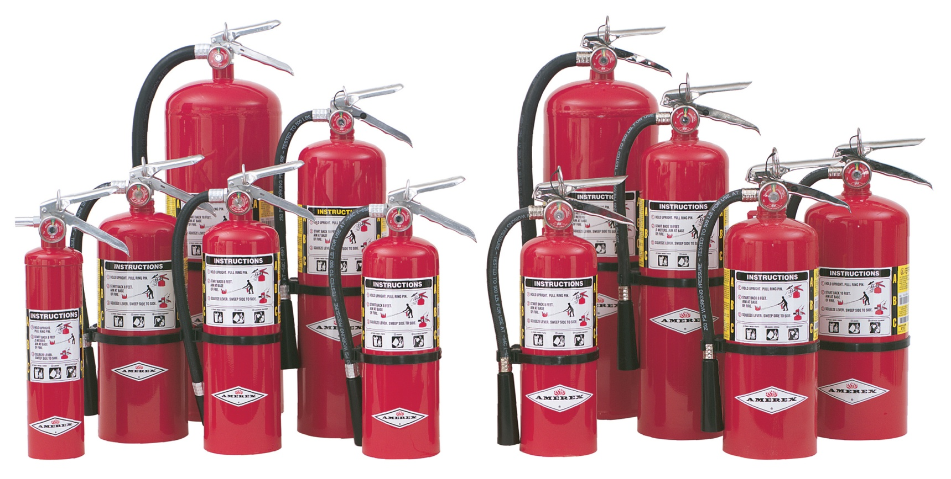
Random Fact: Why learn this?
You can solve an absolute-value inequality to determine the safe range for the pressure of a fire extinguisher.

Slide 5
Introduction:
When an inequality contains an absolute-value expression, you can rewrite it as a compound inequality.

Slide 6
The inequality $\left|x\right|<5$ is all real numbers whose distance from 0 is less than 5 units.
The solutions are all numbers between -5 AND 5.
x > - 5 AND x < 5
So… $\left|x\right|<5$ can be rewritten as -5 < x < 5.

Slide 7
Absolute-Value Inequalities Involving <
The solution to the inequality $\left|x\right|<a$ is
–a < x < a
x > -a AND x < a
The same is true for $≤$.

Slide 8
Example 1:
Solve each inequality and graph the solution.
a) $\left|x\right|+3<12$
$\left|x\right|<9$
x > -9 AND x < 9
-9 < x < 9

Slide 9
Example 1:
Solve each inequality and graph the solution.
b) $\left|x+4\right|≤2$
x + 4 ≥ -2 AND x + 4 ≤ 2
x ≥ -6 AND x ≤ -2
-6 ≤ x ≤ -2

Slide 10
The inequality $\left|x\right|>5$ is all real numbers whose distance from 0 is greater than 5 units.
The solutions are all numbers less than -5 OR greater than 5.
x < - 5 OR x > 5
So… $\left|x\right|>5$ can be rewritten as x < - 5 OR x > 5

Slide 11
Absolute-Value Inequalities Involving >
The solution to the inequality $\left|x\right|>a$ is
x < -a OR x > a
The same is true for $≥$.

Slide 12
Example 2:
Solve each inequality and graph the solution.
a) $\left|x\right|+14≥19$
$\left|x\right|$ $≥$ 5
x ≤ -5 OR x ≥ 5

Slide 13
Example 2:
Solve each inequality and graph the solution.
b) 3 + $\left|x+2\right|>5$
$\left|x+2\right|>2$
x + 2 < -2 OR x + 2 > 2
x < -4 OR x > 0

Slide 14
Good Way to Remember:
Less thAND → AND
GreatOR → OR

Slide 15
Homework:
2.7 Exercises
Examples: 20 – 31
Chapter 2 Test on Thursday

Slide 16
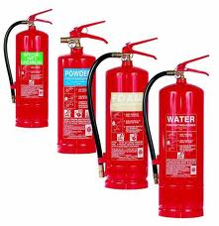
Example 3:
Some fire extinguishers contain pressurized water.
The water pressure should be 162.5 psi, but it is acceptable for the pressure to differ from this value by at most 12.5 psi.
Write and solve an absolute-value inequality to find the range of acceptable pressures.
Graph the solutions.
Solution:
The difference between p and the ideal pressure is at most 12.5 psi
$$\left|p−162.5\right|≤12.5$$
$$p−162.5≥−12.5 AND p−162.6≤12.5$$
$$p≥150 AND p≤175$$
$$150≤p≤175$$

Slide 17
When solving an absolute-value inequality:
If you get a statement that is true for ALL values of the variable, the solution is ALL REAL NUMBERS.
If you get a FALSE statement, the solution is NO SOLUTION.

Slide 18
Example 4:
Solve each inequality and graph.
a) $\left|x+4\right|−5>−8$
$\left|x+4\right|>−3$
Absolute value expressions are ALWAYS non-negative.
Solution: ALL REAL NUMBERS

Slide 19
Example 4:
Solve each inequality and graph.
b) $\left|x−2\right|+9<7$
$\left|x−2\right|<−2$
Absolute value expressions are NEVER NEGATIVE.
Solution: NO SOLUTION

Slide 20
Now, how do you write an absolute value inequality when given the graph?

Slide 21
Steps for Writing the Absolute-Value Inequality for a Graph:
Step 1: Find the midpoint of the two “endpoints.”
Step 2: Find the distance from the midpoint to the “endpoints.”
Step 3: If it is an AND, use < for an open circle and ≤ for a closed circle.
If it is an OR, use > for an open circle and ≥ for a closed circle.
Step 4: Write the Inequality as
$$\left|x−Midpt\right|<Distance from midpt to endpt$$
Or use >, ≤, ≥.

Slide 22
Example 5:
Write an absolute-value inequality for each graph.
a)
Step 1: Midpoint = (-2 + 12)/2 = 5
Step 2: Distance from midpoint to endpoint = 7
Step 3: This is an OR with a closed dot. Use ≥.
Step 4: $\left|x−Midpt\right|≥Distance from midpt to endpt$
$$\left|x−5\right|≥7$$

Slide 23
Example 5:
Write an absolute-value inequality for each graph.
b)
Step 1: Midpoint = (-3 + 2)/2 = -½
Step 2: Distance from midpoint to endpoint = 2½
Step 3: This is an AND with an open dot. Use <.
Step 4: $\left|x−Midpt\right|<Distance from midpt to endpt$
$$\left|x−−\frac{1}{2}\right|<2\frac{1}{2}$$
$$\left|x+\frac{1}{2}\right|<2\frac{1}{2}$$

Slide 24
Exit Ticket (5 minutes)
DESCRIBE how the solutions of 7│x│≤ 21 are different from the solutions of 7│x│< 21 .

Slide 25
Homework:
2.7 Additional Practice Problems Worksheet
Chapter 2 Test on Thursday

