Slide 1
Solving Equations by Multiplying or Dividing
Section 1.3

Slide 2
Objective:
Solve one-step equations in one variable using multiplication or division.

Slide 3
Random fact: Who uses this?
Pilots can make quick calculations by solving one-step equations.

Slide 4
Solving Equations
Solving equations with multiplication and division is similar to solving equations with addition and subtraction.
Isolate the variable by using inverse operations.
Keep the equation balanced!

Slide 5
Example 1: Solving Equations Using Multiplication
-4 = k/-5
k = 20
b) m/3 = 1.5
m = 4.5
-8 = j/3
j = -24

Slide 6
Example 2: Solving Equations by Using Division
a) 7x = 56
x = 8
b) 13 = -2w
w = -6.5
c) -4.8 = -6v
v = 0.8

Slide 7
Dividing is the same thing as multiplying by the reciprocal.
This may be easier than dividing.
This is usually the case with FRACTIONS!

Slide 8
Example 3: Solving Equations with Fractions
a) 5/6 w = -20
w = -24
b) 3/16 = 1/8 z
z = 3/2
c) 5/9 v = 35
v = 63

Slide 9
Example 4: Solving Equations with a Negative in Front of the Variable.
a) –x = 3
x = -3
b) -5 = -m
m = 5
c) –s = -1
s = 1

Slide 10
Multiplication and Division Properties of Equality
You can multiply (or divide) both sides of an equation by a non-zero number, and the statement will still be true.

Slide 11
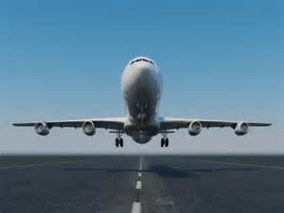
Example 5:
The distance in miles from the airport that a plane should begin descending, divided by 3, equals the plane’s height above the ground in thousands of feet.
If a plane is 10,000 feet above the ground, write and solve an equation to find the distance the pilot should begin descending.
d/3 = h
d/3 = 10
d = 30
The pilot should start descending 30 miles from the airport.

Slide 12
Homework:
1.3 Additional Practice Worksheet

