Slide 1
Solving for a Variable
Section 1.6

Slide 2
Objectives:
Solve a formula for a given variable.
Solve an equation in two or more variables for one of the variables.

Slide 3
Classwork:
1.6 Exploration:
Solving for a Variable

Slide 4
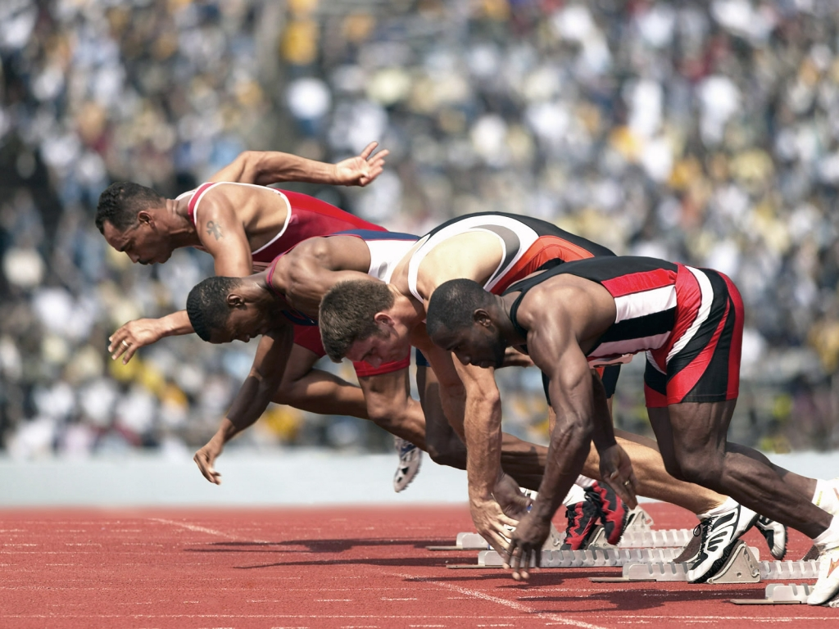
Random Fact: Who uses this?
Athletes can “rearrange” the distance formula to calculate their average speed.

Slide 5
Definition
A formula is an equation that states a rule for a relationship among quantities.
You can rearrange a formula to isolate any variable by using inverse operations.
This is called solving for a variable.

Slide 6
Solving for a Variable
Step 1: Locate the variable you are asked to solve for in the equation.
Step 2: Identify the operation on this variable and the order in which they are applied.
Step 3: Use the inverse operations to undo operations and isolate the variable.

Slide 7
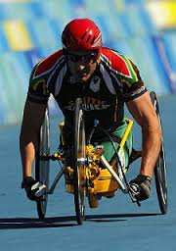
Example 1:
In 2004, Earnest Van Dyk won the wheelchair race of the Boston Marathon with a time of 1.3 hours.
The race was 26.2 miles.
What was his average speed?
Use the formula: Distance = Rate x Time
d = rt
Solve for r.
r = d/t
Now plug in the information.
r = 26.2/1.3
r ≈ 20.2 miles per hour.

Slide 8
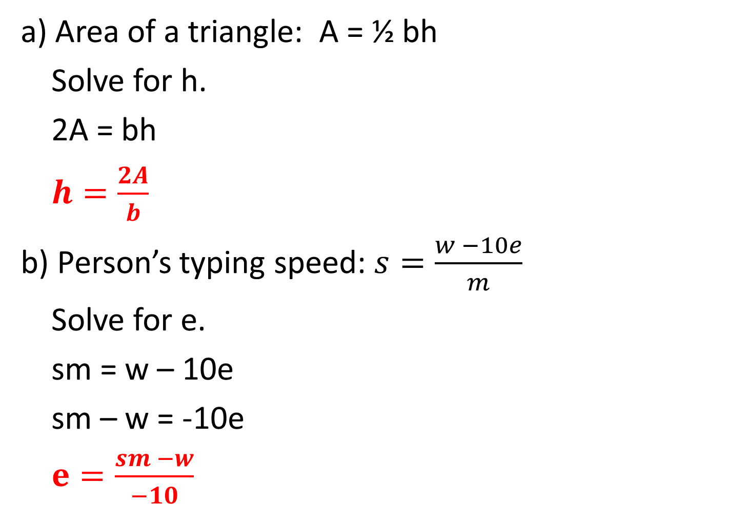
Example 2:
a) Area of a triangle: A = ½ bh
Solve for h.
2A = bh
$h=\frac{2A}{b}$
b) Person’s typing speed: $s=\frac{w −10e}{m}$
Solve for e.
sm = w – 10e
sm – w = -10e
$e=\frac{sm −w}{−10}$

Slide 9
Example 2:
c) Fahrenheit in terms of degrees Celsius:
$$F=\frac{9}{5}C+32$$
Solve for C.
$$F −32=\frac{9}{5}C$$
$$\frac{5}{9}(F −32)=\frac{5}{9}·\frac{9}{5}C$$
$$C=\frac{5}{9}(F −32)$$

Slide 10
Definition:
A formula is a type of literal equation.
A literal equation is an equation with two or more variables.
To solve for one of the variables, use inverse operations.

Slide 11

Example 3:
a) Solve x + y = 15 for x.
x = 15 – y
b) Solve pq = x for q.
$q=\frac{x}{p}$
c) Solve 5 – b = 2t for t
$t=\frac{5−b}{2}$
d) Solve $D=\frac{m}{V}$ for V.
DV = m
$V=\frac{m}{D}$

Slide 12
Homework:
1.6 Additional Practice Worksheet

