Slide 1
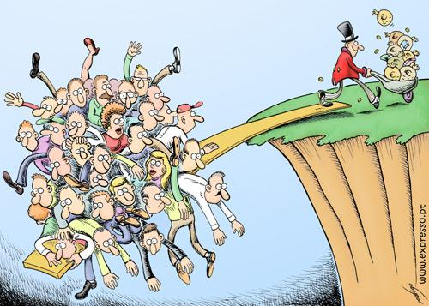
Solving Inequalities by Adding or Subtracting
Section 2.2

Slide 2
Objectives:
Solve one-step inequalities by using addition.
Solve one-step inequalities by using subtraction.

Slide 3
Classwork:
Exploration:
Solving Inequalities by Adding or Subtracting

Slide 4
Random Fact: Who uses this?
You can use inequalities to determine how many more photos you can take.

Slide 5
Solving one-step inequalities is similar to solving one-step equations.
To solve an inequality, isolate the variable using the properties of inequality and inverse operations.

Slide 6
Addition and Subtraction Properties of Inequality.
Addition:
If a < b, then a + c < b + c.
If a > b, then a + c > b + c.
Subtraction:
If a < b, then a – c < b – c.
If a > b, then a – c > b – c.
The same is true for ≤ and ≥.

Slide 7
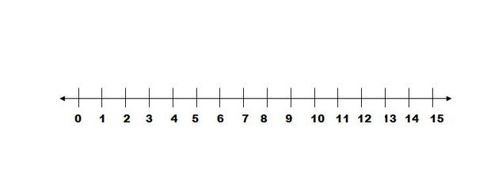
Example 1:
Solve each inequality and graph its solution.
a) x + 9 < 15
x < 6

Slide 8
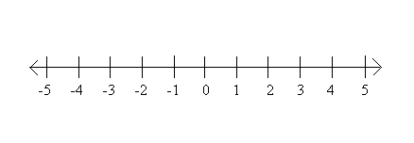
Example 1:
Solve each inequality and graph its solution.
b) d – 5 ≥ -7
d ≥ -2

Slide 9
Example 1:
Solve each inequality and graph its solution.
c) 0.7 ≤ n – 0.4
1.1 ≤ n
n ≥ 1.1

Slide 10
Example 2:
The memory in Tanya’s phone allows her to take up to 20 pictures.
Tanya has already taken 16 pictures.
Write, solve, and graph an inequality to show how many more pictures Tanya can take.
Solution:
# taken + # left is at most twenty.
16 + x ≤ 20
x ≤ 4
She can’t take a fraction of a photo, so…
she can take 0, 1, 2, 3, or 4 more photos.
Graph:

Slide 11
Example 3:
Ms. Nugent wants to buy an antique bracelet at an auction.
She is willing to bid no more than $550.
So far, the highest bid is $475
Write and solve an inequality to determine the amount that Ms. Nugent can add to the bid.
Highest bid + amount added to bid is no more than $550.
475 + x ≤ 550
x ≤ 75
She can add no more than $75 to the bid.

Slide 12
Exit Ticket (5 minutes)
Explain how the Addition and Subtraction Properties of Inequality are like the Addition and Subtraction Properties of Equality.

Slide 13
Classwork:
Worksheet
Solving Inequalities Using Addition and Subtraction

Slide 14
Homework:
Worksheet: Solve Inequalities using Addition and Subtraction

