Slide 1
Solving Inequalities by Multiplying or Dividing
Section 2.3

Slide 2
Objectives:
Solve one-step inequalities by using multiplication.
Solve one-step inequalities by using division.

Slide 3
Classwork:
Exploration:
Solving Inequalities by Multiplying or Dividing

Slide 4
Random Fact: Who uses this?
You can solve an inequality to determine how much you could buy with a certain amount of money.

Slide 5
Solving inequalities is similar to solving equations.
To solve an inequality with multiplication or division, undo the operation by dividing or multiplying both sides by the same number.

Slide 6
Multiplication and Division Properties of Inequality
Let c be a positive number.
Multiplication:
If a < b, then ac < bc.
If a > b, then ac > bc.
Division:
If a < b, then $\frac{a}{c}<\frac{b}{c}$.
If a > b, then $\frac{a}{c}>\frac{b}{c}$.
The same is true for ≤ and ≥.

Slide 7
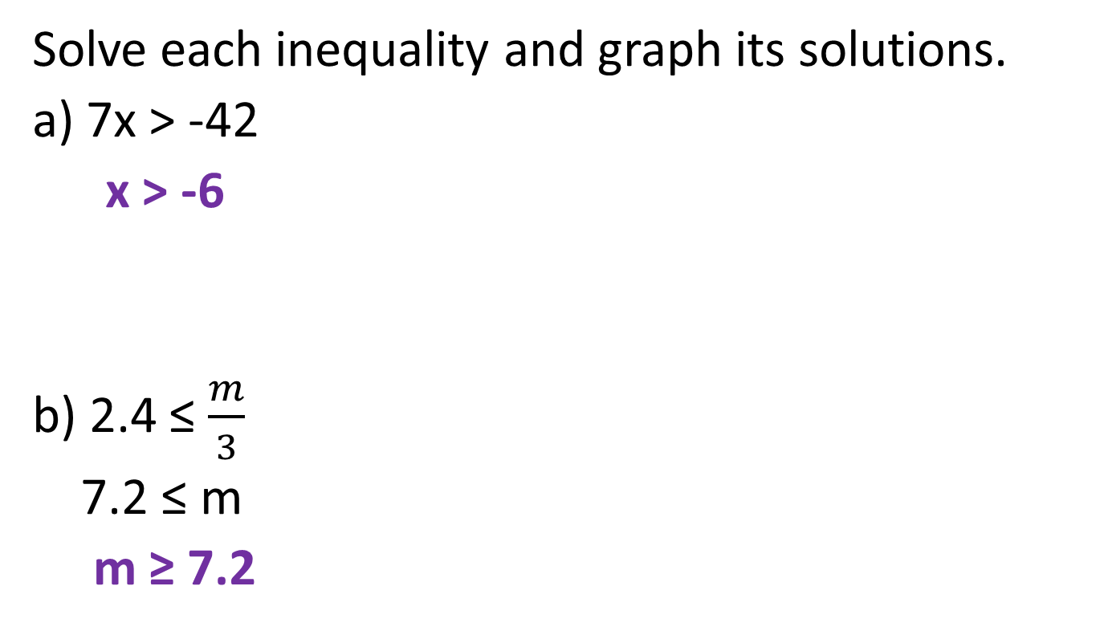
Example 1:
Solve each inequality and graph its solutions.
a) 7x > -42
x > -6
b) 2.4 ≤ $\frac{m}{3}$
7.2 ≤ m
m ≥ 7.2

Slide 8
Example 1:
Solve each inequality and graph its solutions.
c) ¾r < 12
$\frac{4}{3}·\frac{3}{4}r<\frac{4}{3}·12$
r < 16

Slide 9
What About Negatives????
IMPORTANT:
Whenever you multiply or divide by a negative number, you MUST reverse the inequality symbol.

Slide 10
Multiplication and Division Properties of Inequality
Let c be a negative number.
Multiplication:
If a < b, then ac > bc.
If a > b, then ac < bc.
Division:
If a < b, then $\frac{a}{c}>\frac{b}{c}$.
If a > b, then $\frac{a}{c}<\frac{b}{c}$.
The same is true for ≤ and ≥.

Slide 11
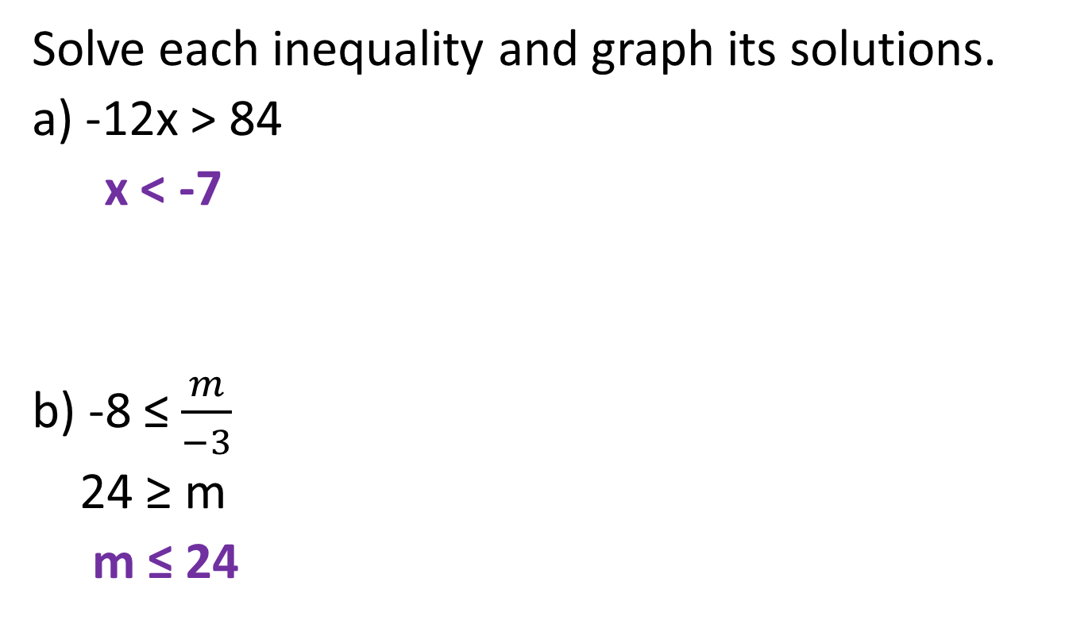
Example 2:
Solve each inequality and graph its solutions.
a) -12x > 84
x < -7
b) -8 ≤ $\frac{m}{−3}$
24 ≥ m
m ≤ 24

Slide 12
Example 3:
Ryan has a $16 gift card for a health store where a smoothie costs $2.50.
What are the possible number of smoothies Ryan can buy?
Write and solve an inequality.
$2.50 times # of smoothies is at most $16.00
2.5s ≤ 16
s ≤ 6.4
You can not buy a fraction of a smoothie so…
Ryan can buy 0, 1, 2, 3, 4, 5, or 6 smoothies.

Slide 13
Exit Ticket (5 minutes)
Compare the Multiplication and Division Properties of Inequality to the Multiplication and Division Properties of Equality.

Slide 14
Classwork:
Worksheet:
Solving One-Step Inequalities by Multiplying or Dividing

Slide 15
Homework:
2.3 Additional Practice Problems

