Slide 1
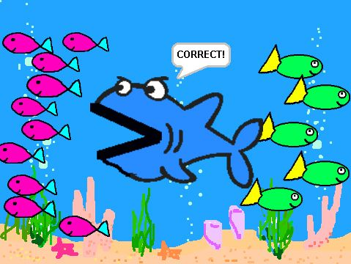
Solving Two Step and Multi-Step Inequalities
Section 2.4

Slide 2
Objective:
Solve inequalities that contain more than one operation.

Slide 3
Classwork:
Exploration:
Solving Two-Step and Multi-Step Inequalities

Slide 4
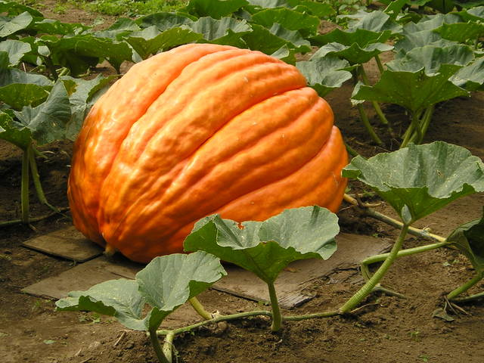
Random Fact: Who uses this?
Contestants at a county fair can solve an inequality to find how many pounds a prize-winning pumpkin must weigh.

Slide 5
Introduction:
Inequalities that have more than one operation require more than one step to solve.
Use inverse operations to isolate the variable.

Slide 6
Example 1:
Solve each inequality and graph the solution:
a) 45 + 2b > 61
2b > 16
b > 8

Slide 7
Example 1:
Solve each inequality and graph the solution:
b) 8 – 3y ≥ 29
– 3y ≥ 21
y ≤ -7

Slide 8
To solve more complicated inequalities, you may need to simplify either side of the inequality first by using:
The order of operations.
Combining like terms.
The distributive property.

Slide 9
Example 2:
Solve each inequality and graph the solution:
a) 2 – (-10) > -4t
2 + 10 > -4t
12 > -4t
-3 < t
t > -3

Slide 10
Example 2:
Solve each inequality and graph the solution:
b) -4(2 – x) ≤ 8
-8 + 4x ≤ 8
4x ≤ 16
x ≤ 4

Slide 11
Example 2:
Solve each inequality and graph the solution:
c) $\frac{2}{3}f+ \frac{1}{2}>\frac{1}{3}$
$\frac{2}{3}f>\frac{2}{6}−\frac{3}{6}$
$\frac{2}{3}f>−\frac{1}{6}$
$\frac{3}{2}·\frac{2}{3}f>\frac{3}{2}·−\frac{1}{6}$
$f>−\frac{1}{4}$

Slide 12
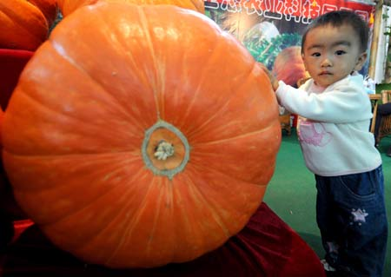
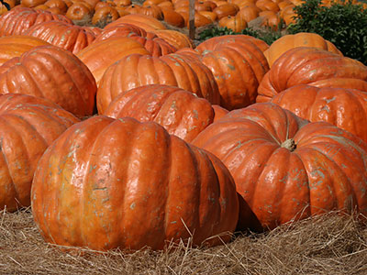
Example 3:
To win the blue ribbon for the “Heaviest Pumpkin Crop” at the county fair, the average weight of John’s two pumpkins must be greater than 819 lbs.
One of his pumpkins weighs 887 lbs.
How many pounds must the second pumpkin weigh in order for him to win the blue ribbon?
Solution:
Write and solve an inequality.
Let p be the weight of the second pumpkin.
$$\frac{887+p}{2}>819$$
$$2·\frac{887+p}{2}>2·819$$
$$887+p >1638$$
$$p >751$$
The second pumpkin must weigh more than 751 pounds.

Slide 13
Exit Ticket (3 minutes)
DESCRIBE two sets of steps for solving the inequality $\frac{x+5}{3}>7.$
What is the solution?

Slide 14
Classwork:
Multi-Step Inequalities Worksheet

Slide 15
Homework:
2.4 Additional Practice Problems Worksheet

