Slide 1
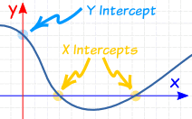
Using Intercepts
Section 4.2

Slide 2
Objectives
Find x- and y-intercepts and interpret their meanings in real world situations.
Use x- and y-intercepts to graph lines.

Slide 3
Classwork:
4.2 Exploration

Slide 4
Random Fact: Who uses this?
Divers can use intercepts to determine the time a safe ascent will take.

Slide 5
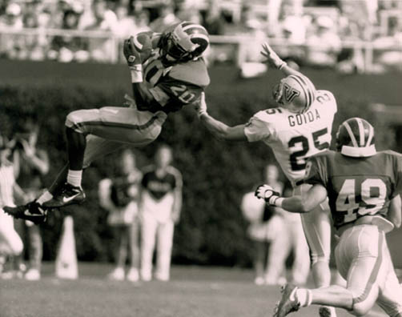
What does it mean to INTERCEPT a pass in football?
The path of the defender crosses the path of the thrown football.
In algebra, what are x- and y-intercepts?

Slide 6
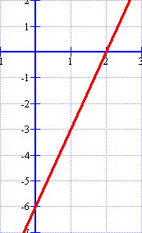
What are the x- and y-intercepts?
The x-intercept is where the graph crosses the x-axis.
The y-coordinate is always 0.
The y-intercept is where the graph crosses the y-axis.
The x-coordinate is always 0.
(2, 0)
(0, -6)

Slide 7
The Intercepts
The intercepts are where the line crosses the axis.
Y-Intercept = 6
Y
X-Intercept = 2
X

Slide 8
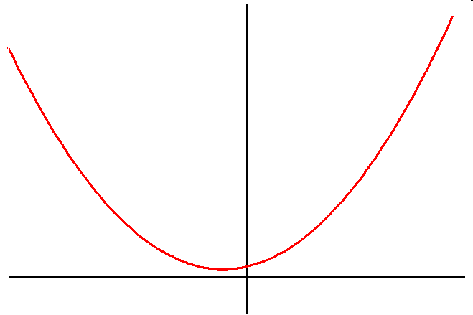
Intercepts of a Graph
A graph can have one intercept
y
x

Slide 9
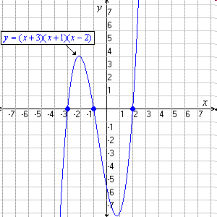
Intercepts of a Graph
A graph can have several intercepts

Slide 10
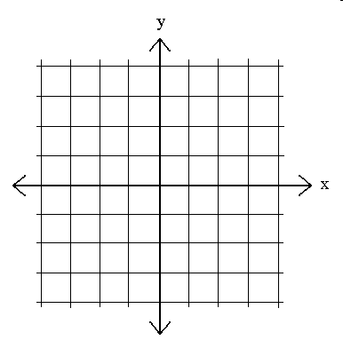
Intercepts of a Graph
Or a graph could have no intercept.

Slide 11
Example 1: Find the x- and y-intercepts. x - 2y = 12
x-intercept: Plug in 0 for y.
x - 2(0) = 12
x = 12; (12, 0)
y-intercept: Plug in 0 for x.
0 - 2y = 12
y = -6; (0, -6)

Slide 12
Here is the graph of x - 2y = 12
Use the graph to check your answer.
12
-12
-6
6
(12, 0)
(0, -6)
-12

Slide 13
Example 2: Find the x- and y-intercepts. y² = x + 4
x-intercept: Plug in 0 for y.
0 = x + 4
x = - 4
x-intercept: (-4, 0)
y-intercept: Plug in 0 for x.
y² = 0 + 4
y = ±2
y-intercepts: (0, 2) and (0, -2)

Slide 14
Here is the graph of y² = x + 4
Use the graph to check your answer.
4
(0, 2)
(-4, 0)
-2
2
4
(0, -2)
-4

Slide 15
Example 3: What is the x-intercept of 3x – 4y = 24?
(3, 0)
(8, 0)
(0, -4)
(0, -6)
You try this one.
1 | 2 | 3 | 4 | 5 | 6 | 7 | 8 | 9 | 10 | 11 | 12 | 13 | 14 | 15 | 16 | 17 | 18 | 19 | 20
21 | 22 | 23 | 24 | 25 | 26 | 27 | 28 | 29 | 30 | 31 | 32

Slide 16
Example 4: What is the y-intercept of -x + 2y = 8?
(-1, 0)
(-8, 0)
(0, 2)
(0, 4)
And this one.
1 | 2 | 3 | 4 | 5 | 6 | 7 | 8 | 9 | 10 | 11 | 12 | 13 | 14 | 15 | 16 | 17 | 18 | 19 | 20
21 | 22 | 23 | 24 | 25 | 26 | 27 | 28 | 29 | 30 | 31 | 32

Slide 17
Example 5: What is the y-intercept of x = 3?
(3, 0)
(-3, 0)
(0, 3)
None
And this one.
1 | 2 | 3 | 4 | 5 | 6 | 7 | 8 | 9 | 10 | 11 | 12 | 13 | 14 | 15 | 16 | 17 | 18 | 19 | 20
21 | 22 | 23 | 24 | 25 | 26 | 27 | 28 | 29 | 30 | 31 | 32

Slide 18
Homework:
4.2 Homework #1: Using Intercepts

Slide 19
Example 6:
Trish can run the 200m dash in 25 seconds.
The function f(x) = 200 – 8x gives the distance remaining to run after x seconds.
a) Graph this function and find the intercepts.
x-intercept is (25, 0)
y-intercept is (0, 200)
200
150
100
50
0
x = time in sec | f(x) = remaining distance
0 | 200
6 | 152
12 | 104
18 | 56
25 | 0
Remaining Distance in Meters
0 6 12 18 24
Time in Seconds

Slide 20
Example 6:
Trish can run the 200m dash in 25 seconds.
The function f(x) = 200-8x gives the distance remaining to run after x seconds.
x-intercept is (25, 0)
y-intercept is (0, 200)
b) What does each intercept represent?
x-intercept – She will finish the race in
25 seconds.
y-intercept – The number of meters
she has to run at the start
of the race is 200 meters.
200
150
100
50
0
Remaining Distance in Meters
0 6 12 18 24
Time in Seconds

Slide 21
How to use intercepts to graph linear functions:
Step 1: Find the x-intercept and plot the point.
Step 2: Find the y-intercept and plot the point.
Step 3: Connect the two points with a line.

Slide 22
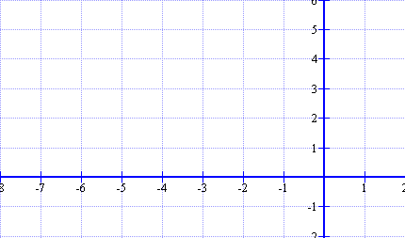
Example 7: Graphing with intercepts: -2x + 3y = 12
Find your x-intercept:
Let y = 0
-2x + 3(0) = 12
x = -6; (-6, 0)
Find your y-intercept:
Let x = 0
-2(0) + 3y = 12
y = 4; (0, 4)
3. Graph both points and draw a line through them.

Slide 23
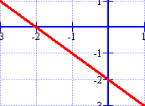
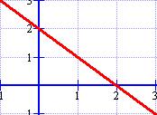
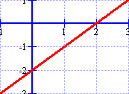
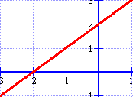
Example 8: Which is the graph of y = x + 2?
.
.
.
.
You try this one.

Slide 24
Exit ticket( 5 minutes)
A function has an x-intercept of 4 and a y-intercept of 2.
Name two points on the graph of this function and EXPLAIN how you knew they were points on the graph.

Slide 25
Homework:
4.2 Homework #2: Using Intercepts

