Slide 1
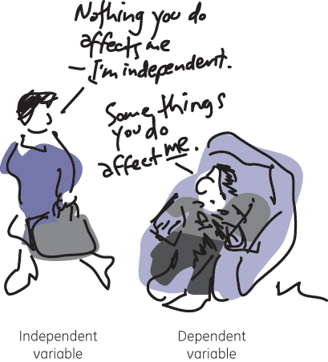
Variables and Expressions
Section 1.1

Slide 2
Objectives:
Translate between words and algebra
Evaluate algebraic expressions

Slide 3
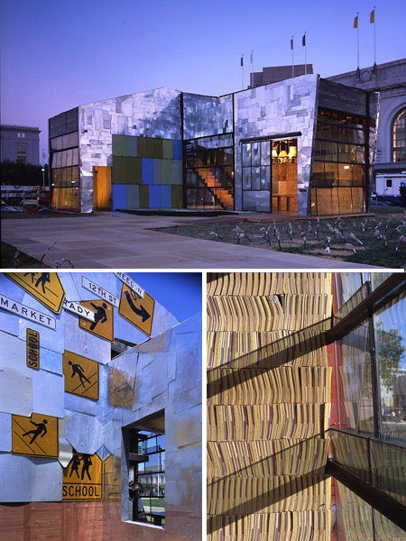
Random Fact: Why learn this?
Variables and expressions can be used to determine how many plastic drink bottles must be recycled to make enough carpet for a house.

Slide 4
Definitions:
A variable is a letter or symbol used to represent a value that can change.
A constant is a value that does not change.
A numerical expression may contain only constants and/or operations.
An algebraic expression may contain variables, constants, and/or operations.

Slide 5
List different words related to the operation:
+
Plus, sum, increased by, add, put together, combine.
-
Minus, difference, less than, find how much more or less.
x
Times, of, multiply, product.
÷
Divided by, quotient, separate into equal groups.

Slide 6
Example 1:
Give two ways to write each algebraic expression in words.
a) x + 5
The sum of x and 5
x increased by 5
b) m – 7
The difference of m and 7
7 less than m
c) 2y
2 times y
The product of 2 and y
d) k ÷ 5
k divided by 5.
The quotient of k and 5.

Slide 7
Example 2:
a) Bob reads 25 pages per hour. Write the expression
for the number of pages he reads in h hours.
25h
Alex is two years younger than Sam, who is y years
old. Write an expression for Alex’s age.
y – 2
c) Joey earns $5 for each car he washes. Write an
expression for the number of cars Joey must wash
to earn d dollars.
d/5

Slide 8
Evaluating
To evaluate an algebraic expression, substitute numbers for the variables and simplify.

Slide 9
Example 3:
Evaluate each expression for a = 4, b = 7, and c = 2.
a) b – c
5
b) ac
8
c) a/c
2

Slide 10
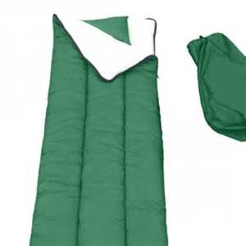
Example 4:
Approximately eighty-five bottles must be recycled to produce the fiberfill for a sleeping bag.
a) Write the expression for the number of bottles needed to make s sleeping bags.
85s
b) Find the number of bottles needed to make 20, 50, and 125 sleeping bags.
1700; 4250; 1/,625

Slide 11
Homework:
Section 1.1 Additional Practice Worksheet

Slide 12
Classwork
Section 1.1 Technology Lab - Evaluating Expressions by Graphing

